Slide 1
Staphylococcus aureus Bacteriuria: What does it signify and what should be done?
Vincent Anella, PharmD, BCIDP

Slide 2
Disclosures
No disclosures
https://physicians.utah.edu/echo/clinical-support-areas/post-acute-care

Slide 3
Patient Case 1
DH is a 25 YO female patient who presented to the emergency department reporting dysuria and increased urinary frequency. A urine culture is obtained, and the patient is discharged on cephalexin for empiric UTI treatment. The urine culture resulted with 50,000 CFU’s of Methicillin susceptible Staphylococcus aureus. The patient is contacted and reports that she is no longer symptomatic. What further actions should be taken?
Continue cephalexin and advise the patient to finish her course as prescribed
Evaluate for an invasive S. aureus infection by obtaining blood cultures
Consider obtaining new culture as this could be contamination
Discontinue antibiotics as the patient is asymptomatic
https://physicians.utah.edu/echo/clinical-support-areas/post-acute-care

Slide 4
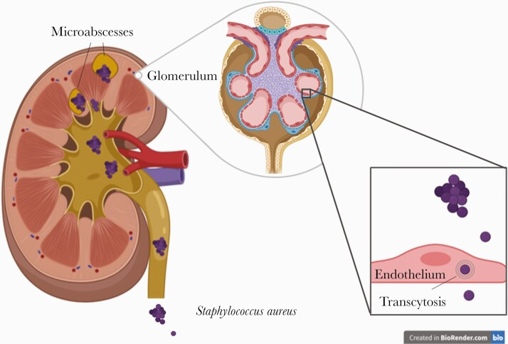
Background
Staphylococcus aureus Bacteriuria (SABU)
S. aureus has not been regarded as a urinary pathogen ~ 4% of urine cultures grow S. aureus
Lacks the ability to adhere to the walls of the urethra
Clinical significance is a spectrum
Contamination
Colonization
Primary urinary tract infection
S. aureus bacteremia(SAB) hematogenous spread
Mortality range: 10-40%
Schuler F, Barth PJ, Open Forum Infect Dis. 2021
https://physicians.utah.edu/echo/clinical-support-areas/post-acute-care

Slide 5
Is SABU a risk factor for complicated SAB?
Study Design | Prospective observational study including all adults with SAB admitted within a 2-year period
Demographics | N = 104 Male: N = 75 (73%) Median Age: 64 Severe sepsis: 43 (41)
Cultures | 68 patients had urine cultures collected 23 (34%) of which had SABU Patients were already confirmed to be bacteremic prior to urine culture
Outcomes | 45 patients were found to have complicated SAB (endocarditis, osteomyelitis, septic arthritis). In a univariate analysis concomitant bacteriuria (47% vs 19%, P=0.016, χ2=5.8, N=68; RR=2.5) was associated with complicated SAB
Conclusion | SABU is likely a marker of high bacterial burden leading hematogenous seeding of the kidneys
Pulcini, C. et.al., Journal of Infection, 59(4), 240–246
https://physicians.utah.edu/echo/clinical-support-areas/post-acute-care

Slide 6
Describe characteristics of patients with SABU and concomitant SAB
Study Design | Retrospective study evaluating all patients with SABU comparing characteristics of those with and without SAB
Demographics | N = 2054 Median Age: 62 Population predominantly male 51.3%
Outcomes | 175 (6.9%) patients with SABU were found to have concomitant SAB 69.7% of SABU + SAB are elderly male patients 18.5% had a urinary catheter present
Conclusion | SABU + SAB was found predominantly in geriatric male patients with urologic abnormalities, diabetes, and or dementia
Stokes, W et. al. Clinical Infectious Diseases, 69(6), 963–969
https://physicians.utah.edu/echo/clinical-support-areas/post-acute-care

Slide 7
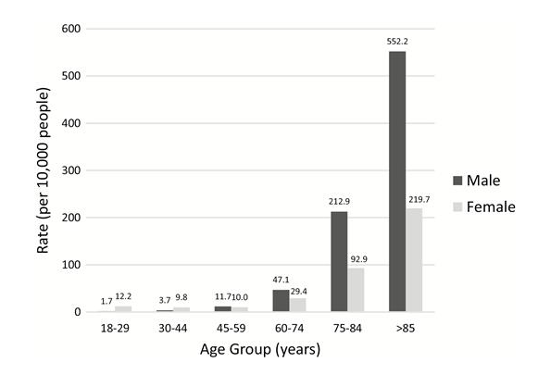
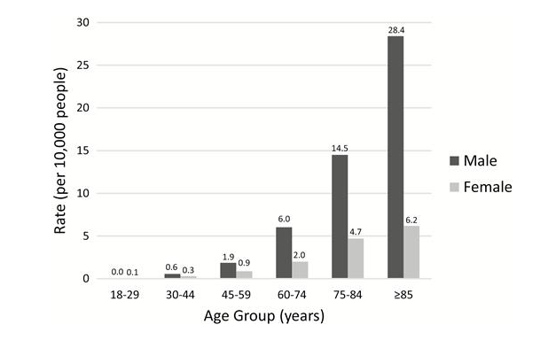
Rate of SABU
Rate of SABU + SAB
https://physicians.utah.edu/echo/clinical-support-areas/post-acute-care

Slide 8
Is SABU associated with deep seated infections and worse prognosis?
Study Design | Meta-analysis of nine relevant studies including N = 1429 patients with SAB
Study Selection | Any study comparing patients with SAB+ SABU and SAB without SABU. Outcomes assessed included the association SABU with endocarditis and bone/joint infections
Outcomes | Endocarditis: 12.8% (34/265) SABU+SAB vs 8.6% (100/1164) SAB OR = 1.47, 95% CI 0.96–2.27 Bone/joint infections: 14.4% (19/132) SABU+SAB vs 6.9% (36/525) SAB OR = 2.39, 95% CI 1.11–5.14
Conclusion | SABU may be a useful maker for complicated disease; however, literature is overall limited. Most studies look at patients with confirmed bacteremia who got a subsequent urine culture but not patients with bacteremia identified first by urine culture.
Karakonstantis, S . Clinical Infectious Diseases, 69(6), 963–969.,
https://physicians.utah.edu/echo/clinical-support-areas/post-acute-care

Slide 9
Patient Case 1
DH is a 25 YO female patient who presented to the emergency department reporting dysuria and increased urinary frequency. A urine culture is obtained, and the patient is discharged on cephalexin for empiric UTI treatment. The urine culture resulted with >50,000 CFU’s of Methicillin susceptible Staphylococcus aureus. The patient is contacted and reports that she is no longer symptomatic. What further actions should be taken?
Continue cephalexin and advise the patient to finish her course as prescribed
Evaluate for an invasive S. aureus infection by obtaining blood cultures
Consider obtaining new culture as this could be contamination
Discontinue antibiotics as the patient is asymptomatic
https://physicians.utah.edu/echo/clinical-support-areas/post-acute-care

Slide 10
Patient Case 1
DH is a 25 YO female patient who presented to the emergency department reporting dysuria and increased urinary frequency. A urine culture is obtained, and the patient is discharged on cephalexin for empiric UTI treatment. The urine culture resulted with >50,000 CFU’s of Methicillin susceptible Staphylococcus aureus. The patient is contacted and reports that she is no longer symptomatic. What further actions should be taken?
Continue cephalexin and advise the patient to finish her course as prescribed
Evaluate for an invasive S. aureus infection by obtaining blood cultures
Consider obtaining new culture as this could be contamination
Discontinue antibiotics as the patient is asymptomatic
?
https://physicians.utah.edu/echo/clinical-support-areas/post-acute-care

Slide 11
Our Response to the Data
A microbiology alert at Intermountain Health was attached to ALL Staph aureus bacteriuria in February of 2023
Patients often get blood cultures if no concomitant blood cultures were obtained
The relevance of follow up blood cultures (FUBC) are unclear
https://physicians.utah.edu/echo/clinical-support-areas/post-acute-care
Notes:
Increasing follow-up blood cultures (FUBC) in select patients with SABU might lead to increased SAB detection and provide opportunities for earlier treatment. SABU detected ≥ 48 hours before SAB has been associated with higher risk of death compared to simultaneous SAB and SABU.⁷ More timely identification of SAB in these patients might improve outcomes.
Education targeting the Emergency Departments (ED) was disseminated in July 2021. Positive cultures were reviewed daily in EDs, often by a dedicated ED pharmacist. ED Pharmacists were encouraged to discuss SABU with a physician and to recommend evaluation for SAB. In October 2021, a high priority electronic alert for all hospital and ED SABU cases was deployed for ID pharmacists to review and resolve during business hours.
As a result, some authors have recommended that at minimum, blood cultures should be obtained in patients with SABU and evidence of systemic inflammatory respons

Slide 12
Describe the Impact of the Microbiology Alert
Follow up Blood Cultures
Between 1 and 5 days after index SABU
Staph aureus Bacteremia within 90 days
Early SAB between 1 and 5 days
Late SAB between 6 and 90 days
ED Revisits
Early and late
Hospital Admissions
Early and late
https://physicians.utah.edu/echo/clinical-support-areas/post-acute-care
Notes:
This project took place in 28 IH hospitals and clinics located in Utah and Idaho.

Slide 13
Demographics
Variable | Pre-intervention (N = 1996) | Post-intervention (N = 544) | P-Value
Male, n (%) | 968 (48.5%) | 245 (45.0%) | 0.17
White, n (%) | 1756 (88.0%) | 483 (88.8%) | 0.66
Hispanic, n (%) | 161 (8.1%) | 49 (8.0%) | 0.66
Age, years (IQR) | 63 (38,76) | 62 (34,77) | 0.44
Urgent care, n (%) | 386 (19.3%) | 122 (22.4%) | 0.13
Emergency care, n (%) | 399 (20.0%) | 110 (20.2%) | 0.91
3213 patients with Staph bacteriuria were identified between June 2019 through January 2024
Patients with blood cultures obtained within 24 hrs of urine culture were excluded
No Staph bacteremia within 14 days prior to urine culture
https://physicians.utah.edu/echo/clinical-support-areas/post-acute-care
Notes:
Pre intervention period June 2019 through January 2023 post intervention Feb 2023 through Jan 2024 2540 included in the analysis
Patients ≥ 18 years of age presenting to emergency department and ambulatory settings with documented SABU were identified from the electronic medical record between June 2019 and January 2024. We excluded patients with confirmed SAB up to 14 days prior to index SABU culture in whom bacteremia was known prior to urine culture results. We also excluded patients with blood cultures obtained within 24 hours of collection of positive urine culture, inferring that bacteremia was at least suspected at the time of urine culture obtainment as evidenced by blood culture collection. The analysis was limited to the first episode of SABU per patient.

Slide 14
https://physicians.utah.edu/echo/clinical-support-areas/post-acute-care

Slide 15
Outcomes
Variable | Pre-intervention (N = 1996) | Post-intervention (N = 544) | P-Value
Staph bacteremia detection within 3 months n (%) | 33 (1.7%) | 14 (2.6%) | 0.22
Early Staph bacteremia within 1 to 5 days n (%) | 12 (0.6%) | 11 (2.0%) | 0.004
Late Staph bacteremia with 6 to 90 days n (%) | 21 (1.1%) | 3 (0.6%) | 0.41
ED revisit within 90 days n (%) | 378 (18.9%) | 151 (27.8%) | < 0.001
Early ED revisit n (%) | 131 (6.6%) | 70 (12.9%) | <0.001
Readmissions within 90 days n (%) | 219 (11%) | 66 (12%) | 0.49
Mortality within 90 days n (%) | 87 (4.4%) | 24 (4.4%)
https://physicians.utah.edu/echo/clinical-support-areas/post-acute-care
Notes:
Overall, 177 patients (8.9%) in the pre-intervention and 112 patients (20.6%) in the post-intervention period had FUBC. In ITS analysis, the initial impact of the intervention was estimated as a 7.2% increase in FUBC (estimated rate 19.8%) relative to the counterfactual had no intervention taken place (estimated rate 7.6%, p<0.0002)
Late S aureus bacteremia, n (%)
17 (1.4%) male
7 (0.5%) female
0.039
We compared pre- and post-intervention groups using Wilcoxon signed-rank test for continuous data and for categorical data Chi-Square or Fisher’s Exact tests (for variables with cells less than 10). ITS was performed in Microsoft Excel and all other statistical analyses were performed using R statistical software package, version 4.2.3 (R Project for Statistical Computing).

Slide 16
Subgroup Analysis by Sex
Similar increases in follow up blood cultures in Males and Females
9.3% vs 8.5% pre-intervention and 20.8% vs 20.4%
Differences in urine collection technique
Catheterized:159 (13.1%) males vs 73 (5.5%) females
Clean Catch: 533 (43.9%) males vs 798 (60.1%) females
Follow up blood cultures positive
Females 0.7% vs 15.6% of males (p < 0.001)
90-day readmissions higher in males
14.3% vs 8.4% (p <0.001)
Deep Seated Infections
~28.6% found to have prostatitis
https://physicians.utah.edu/echo/clinical-support-areas/post-acute-care
Notes:
Despite similar rates of evaluation, FUBC were positive for SAB in 1 (0.7%) of 148 females tested compared to 22 (15.6%) of 141 males tested (p<0.001). Although 90-day ED revisits were similar between males and females (20.7% vs 20.9%; p = 0.91), 90 -day readmissions occurred more frequently in males than females (14.3% vs 8.4%; p <0.001).

Slide 17
Our Study Conclusion
Increased follow up blood cultures
Increased early Staph bacteremia detection (0.6% to 2.0%)
At the cost of increased ED revisits (18.9% to 27.8%)
Low risk population Staph bacteremia detection ~2%
Risk targeted strategies needed
New Microbiology Alert
S. aureus is an uncommon urine pathogen and may be indicative of contamination or spread from invasive infection. Evaluate for signs of invasive disease including prostate infection.
https://physicians.utah.edu/echo/clinical-support-areas/post-acute-care
Notes:
Our findings suggest that routinely ordering FUBC in all patients with SABU is low yield if clinicians are already appropriately obtaining blood cultures in patients with systemic signs and symptoms of invasive disease on initial presentation. In this low-risk population, a high percentage of SABU cases likely represented colonization/contamination or were primary urinary tract infections that responded appropriately to antibiotic treatment

Slide 18
Patient Case 2
JM is a 75 YO male patient who presented to the emergency department reporting dysuria, fever, and increased urinary frequency. A urine culture is obtained, and the patient is discharged on cephalexin for empiric UTI treatment. The urine culture resulted with >100,000 CFU’s of Methicillin susceptible Staphylococcus aureus. The patient is contacted and reports some ongoing fevers but resolution of UTI symptoms. What further actions should be taken?
Continue cephalexin and advise the patient to finish his course as prescribed
Clinically evaluate for an invasive S. aureus infection which could include obtaining blood cultures, etc.
Consider obtaining new culture as this could be contamination
Discontinue antibiotics as the patient is asymptomatic
https://physicians.utah.edu/echo/clinical-support-areas/post-acute-care

Slide 19
Patient Case 2
JM is a 75 YO male patient who presented to the emergency department reporting dysuria, fever, and increased urinary frequency. A urine culture is obtained, and the patient is discharged on cephalexin for empiric UTI treatment. The urine culture resulted with >100,000 CFU’s of Methicillin susceptible Staphylococcus aureus. The patient is contacted and reports some ongoing fevers but resolution of UTI symptoms. What further actions should be taken?
Continue cephalexin and advise the patient to finish his course as prescribed
Clinically evaluate for an invasive S. aureus infection which could include obtaining blood cultures, etc.
Consider obtaining new culture as this could be contamination
Discontinue antibiotics as the patient is asymptomatic
https://physicians.utah.edu/echo/clinical-support-areas/post-acute-care

Slide 20
Conclusion
Staphylococcus aureus is an uncommon bacteria to find in the urine that could represent contamination/colonization or at true urinary tract infection.
In right patient population such as elderly males, patients with urinary tract abnormalities, and those with persistent symptoms clinical evaluation for invasive S. aureus is recommended.
https://physicians.utah.edu/echo/clinical-support-areas/post-acute-care

Slide 21
Questions?

Slide 22
Citations
Karakonstantis, S., Kalemaki, D. (2018). The clinical significance of concomitant bacteriuria in patients with staphylococcus aureus bacteremia. A review and meta-analysis. Infectious Diseases, 50(9), 648–659.
Pulcini, C., Matta, M., Mondain, V., et. Al.(2009). Concomitant staphylococcus aureus bacteriuria is associated with complicated S. aureus bacteremia. Journal of Infection, 59(4), 240–246.
Stokes, W., Parkins, M. D., Parfitt, E. C., et al, (2018). Incidence and outcomes of staphylococcus aureus bacteriuria: A population-based study. Clinical Infectious Diseases, 69(6), 963–969.

