Slide 1
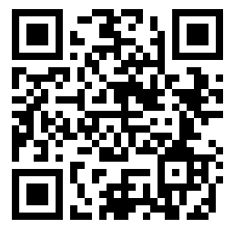
Lightning Presentations

Slide 2
From clues to closure:
Solving a Salmonella mystery
Clarissa Keisling, MPH
2024 Utah One Health Symposium
Notes:
Greetings! I hope you all are enjoying our story time. My name is Clarissa Keisling, I’m an epidemiologist with DHHS. Here is our short story about solving a Salmonella mystery in Utah.

Slide 3
Chapter 1: An evolving mystery
Chapter 2: A cluster of clues
Chapter 3: Uncovering the source
Chapter 4: Mystery solved
From clues to closure:
Solving a Salmonella mystery
Notes:
Our story will explore 4 chapters, looking at all the clues that led our investigation team to solve the outbreak. Buckle up, we’ll be moving quickly through this tale!

Slide 4
Chapter 1: an evolving mystery
Notes:
Once upon a time, in fall of 2023, a mystery began to unfold. Several residents in neighboring counties fell ill. They submitted samples for testing, to figure out what was making them sick.

Slide 5
Chapter 1: an evolving mystery
Notes:
Initially, 5 patients submitted samples for gastrointestinal testing - their results came back as positive for Salmonella.

Slide 6
Chapter 1: an evolving mystery
Notes:
Although Salmonella infections are not uncommon, these initial 5 patients were all infected with the exact same strain, or serotype, of Salmonella, known as S. Livingstone.
Salmonella Livingstone is a very uncommon strain, not normally seen in the US.

Slide 7
Chapter 1: an evolving mystery
Source of infection
Notes:
So, given this unique strain that was found in 5 patients, public health was quick to ask - what was the source of this specific pathogen and how were people getting sick?

Slide 8
Chapter 1: an evolving mystery
No reports from other states
No reported out of state travel
No common restaurants identified
Notes:
Here is what we knew: there were no reports of Livingstone in patients from other states, none of the initial 5 patients reported out of state travel, and during the initial, routine interviews, no common restaurants were identified.
This led us to believe that the source of the pathogen was local here to UT, and may be connected to an uncommon source.

Slide 9
Chapter 1: an evolving mystery
Notes:
Uncommon sources of Salmonella include supplements, powders, pet foods, or other homeopathic products.
Our initial hypothesis was that one of these locally produced products might be the source of the pathogen.

Slide 10
Chapter 2: a cluster of clues
Notes:
We decided to re-interview patients using open-ended interviews. This is where storytelling becomes an important part of public health investigations. Open-ended interviews are less structured than the initial, standard enteric interviews, and allow for flexibility is question asking, and patient response.
In other words, we asked patients to tell us their stories, in hopes that an open-ended approach might help illuminate the source of the outbreak.
We asked specifically about consumption of locally produced products (our “uncommon” sources) AND also asked patients to check their purchase histories to identify any stores or restaurants they may have bought products from or eaten at and may have forgotten to mention during their initial interviews.

Slide 11
Chapter 2: a cluster of clues
Notes:
On January 16th, I started re-interviewing patients with our storytelling and purchase history approach. Within 1 day, I had re-interviewed 4 of the initial 5 patients. After checking purchase histories, all 4 of them reported eating at Restaurant A during the weeks before illness onset.

Slide 12
Chapter 3: uncovering the source
Notes:
However, the clock was ticking – additional cases were actively being identified, and only 3 days later, 8 total patients had reported eating at Restaurant A.

Slide 13
Chapter 3: uncovering the source
Notes:
On Friday January 19th, local public and environmental health officials decided to close the restaurant, and a team was assembled to investigate the location for evidence of the pathogen.

Slide 14
Chapter 3: uncovering the source
Notes:
On January 22nd, a fearless group of public health officials headed to the restaurant to collect food an environmental samples.

Slide 15
Chapter 3: uncovering the source
Food/ingredients
Notes:
Here, you can see some examples of food and ingredients from which samples were collected, including freshly prepared fried rice.

Slide 16
Chapter 3: uncovering the source
Environmental
swabs
Notes:
Here, you can see Willy collecting various environmental swabs from items and areas across the restaurant.

Slide 17
Chapter 3: uncovering the source
Interviews
Stool samples
Notes:
The team also interviewed the restaurant staff and collected stool samples, to see if the staff might have been the source or spread of the pathogen.

Slide 18
Chapter 3: uncovering the source
Notes:
The outbreak strain was isolated from 7 environmental swabs including cleaning equipment, the 3-compartment sink, wooden stools; stove handles; and sauce bottles…

Slide 19
Chapter 3: uncovering the source
Notes:
…as well as from two composite food samples - sauces and prepped veggies from grill station and other ingredients from ingredient preparation area.

Slide 20
Chapter 4: mystery solved...?
Notes:
While these results allowed us to confirm restaurant A as the source of the outbreak, unfortunately, the employee interviews did not tell us how the pathogen might have been introduced to the restaurant. One employee did have the outbreak strain identified in their stool sample, however, they were a recent hire and could not have been the source.

Slide 21
Chapter 4: mystery solved!
3 days
Notes:
Though the source of the pathogen into the restaurant remains a mystery, this story did show how the use of storytelling can enable prompt identification of an outbreak source. In this case, it led to closure of the restaurant within 3 days, likely preventing others from getting sick.

Slide 22
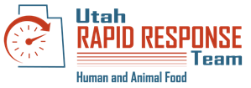
Acknowledgements
Notes:
The mystery could not have been solved without the help of all our amazing partners!

Slide 23
The end!
Clarissa Keisling, MPH
2024 Utah One Health Symposium
Notes:
Thank you for your time

Slide 24
A REVIEW OF RABIES CONTROL POLICIES IN UTAH
COMPLEX AND CONFLICTING STORIES
Matthew Brown

Slide 25
Notes:
BASED ON municipal ordinances from an actual town in Utah –Not an actual specific story

Slide 26
Animal Control in a Small Town in Utah
Police department report: A dog was approached and attacked by a raccoon during the day.
The dog is not vaccinated for rabies
The raccoon has not been captured
The town’s code covers rabies reporting and biting animal rabies quarantine, but not bitten animal quarantine
For guidance, you look to other examples of community code
Notes:
In a small town in Utah, animal control is covered by the local police department; A local resident reports that while on a walk, a raccoon approached and attacked her dog. She did not interact with the animal, but the dog was bitten, and the raccoon ran off. The dog is not vaccinated for rabies
This is not a frequent occurrence, so the department consults the town’s Code of Ordinances. Rabid animal reporting and biting animal quarantine is covered, but not bitten animal. Looking for guidance, the department consults other communities, and county

Slide 27
Rabies Control in Other Communities
Looking for guidance, you seek rabies control policy in other communities, the county, and the state.
What you find:
Other communities: 4-month, 6-month, 14-day and 10-day quarantine and mandatory euthanasia
County-level code: 6-month quarantine under veterinary supervision or immediate euthanasia
State: 4-month quarantine under veterinary supervision or immediate euthanasia
Notes:
For rabies exposure to unvaccinated animals in other communities in the same county, the department finds an incredible variety of times; If the resident does not wish to euthanize her dog possible quarantine times include 10 days, 4 months, and 6 months. The county mandates a strict 6-month quarantine, while the state orders 4 months.
In this situation, what is the appropriate course of action? The most up-to-date version of the Compendium of Rabies Prevention and Control, established by the National Association of State Public Health Veterinarians agrees with the Utah State code in this instance. But would following these guidelines break the county code?
This scenario is not an isolated issue in Utah, but rather altogether too common

Slide 28
The Complexities of Rabies Control
302 jurisdictions: 29 counties, 273 towns and cities
Great variation in rabies control
Quarantine time
Quarantine location
Species covered
Deciding when to test
Rabies test sample handling procedure
Notes:
With 29 counties, and nearly 300 towns and cities, there is great variance in rabies control. Quarantine time is perhaps the most important factor to consider, but other areas of difference include quarantine location, which species are covered, and testing criteria such as deciding when to test, and handling procedures for samples.

Slide 29
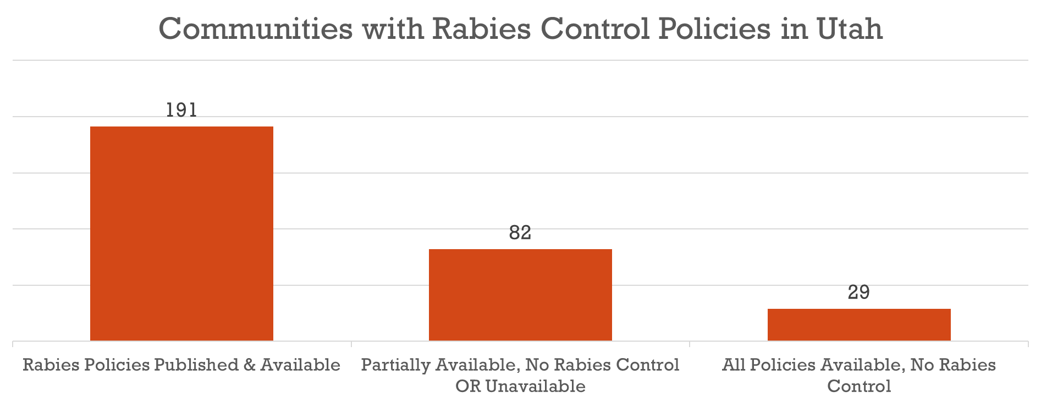
Complexities of Rabies Control
Rabies Control Policies in 302 Jurisdictions
1 County, 15 municipalities adopt the same quarantine times as the Compendium and State Code
Notes:
For rabies policies in Utah, 17 counties and 174 municipalities have rabies control policies in place publicly available. In other jurisdictions, some or all of the code was unavailable for review, OR all was available, but there was no mention of rabies control. Of those 191 communities with rabies control policies, only one county and 15 towns and cities adopted the same quarantine times as the compendium or state code
(Salt Lake County; 13 of its constituent towns and cities, and La Verkin and Castle Dale)
Outside of these communities, rabies control measures included wild variation, particularly in quarantine time for biting animals and bitten animals
29 municipalities have publicly available code, but no rabies control mentioned
82 municipalities have only partially available or unavailable code

Slide 30
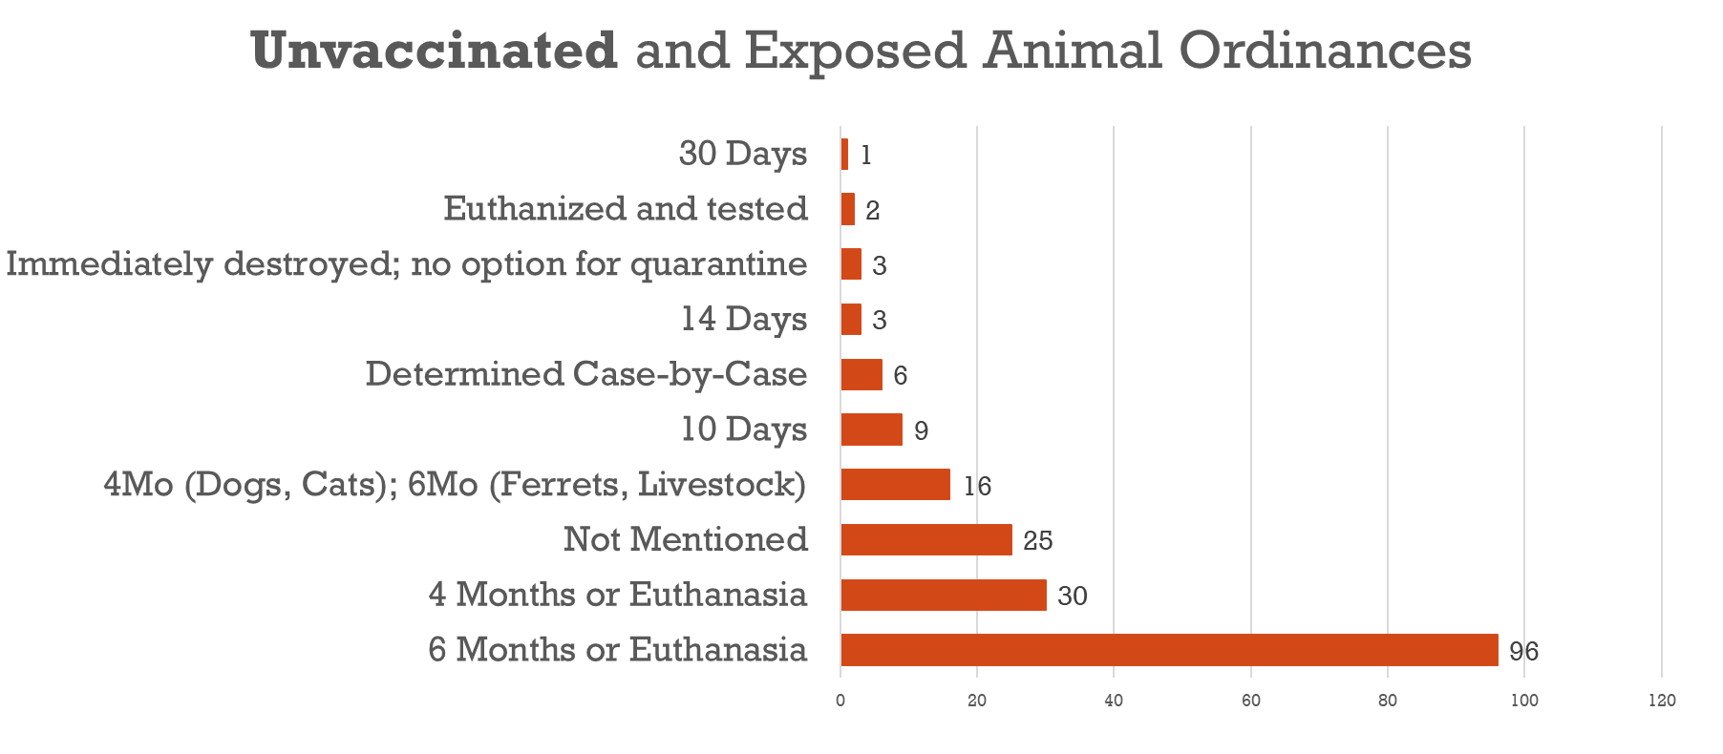
Complexities of Rabies Control, Continued
Notes:
Unvaccinated and exposed animals (such as this case) show the most extreme variation, and the greatest risk to public health risk. Generally, humane euthanasia is the best course of action from a public health standpoint, however quarantine is a possibility. (Click)
A strict quarantine of 4 months in dogs and cats, and 6 months in ferrets, and 6-months of careful owner-observation in valuable livestock are the accepted periods of time per the Rabies compendium and Utah state code
In Utah, the most common quarantine time (by far) is a strict 6-month quarantine. This isn’t unsafe, but poses a greater strain on animal control, municipal shelters, and veterinary hospitals that must house these animals, and the owners that must either pay for housing.
More concerning are the policies that reduce quarantine times. Even 30 days is just a quarter of the time considered “safe” for quarantine, but some jurisdictions quarantine unvaccinated and potentially exposed animals for just 10 days. In these instances, it is very possible for animals to become infected and only develop rabies after the short quarantine period. These animals would be very likely to expose their owners and other animals.

Slide 31
Recommendations for Local Jurisdictions
Establish (and make publicly available) rabies control policy
Characteristics of ideal rabies policy
Adoption of a prepared template ordinance
May defer to higher level (e.g. county or state) ordinance
May defer to Compendium of Rabies Prevention and Control
Update existing ordinance
Quarantine timing
Minimum: Update timing for unvaccinated exposed animals
Notes:
Prepared template ordinance may come from the state

Slide 32
QUESTIONS?

Slide 33
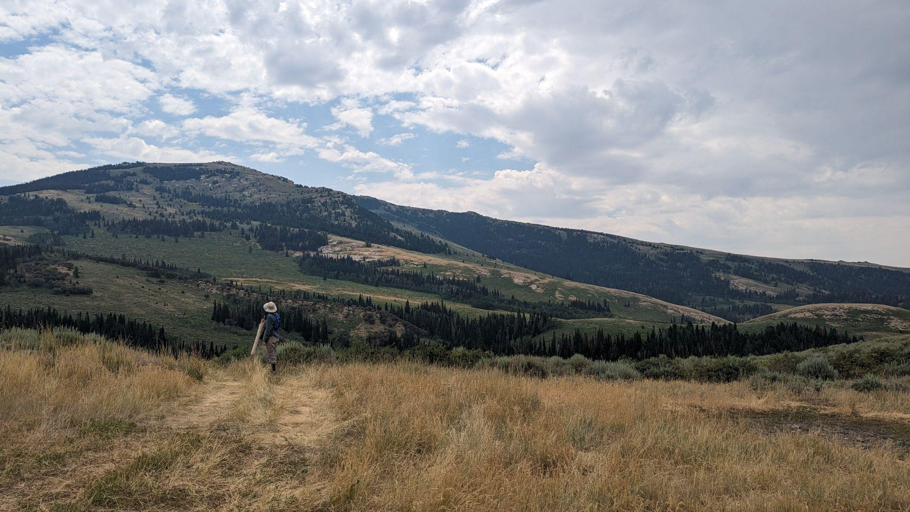
The Trail of the Tick
Ixodes pacificus and Lyme disease risk in Utah
Drew Freshour

Slide 34
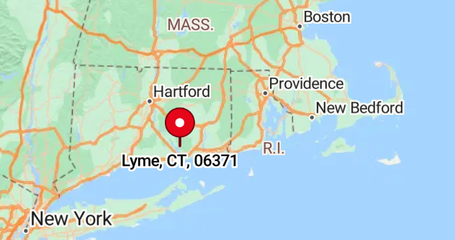
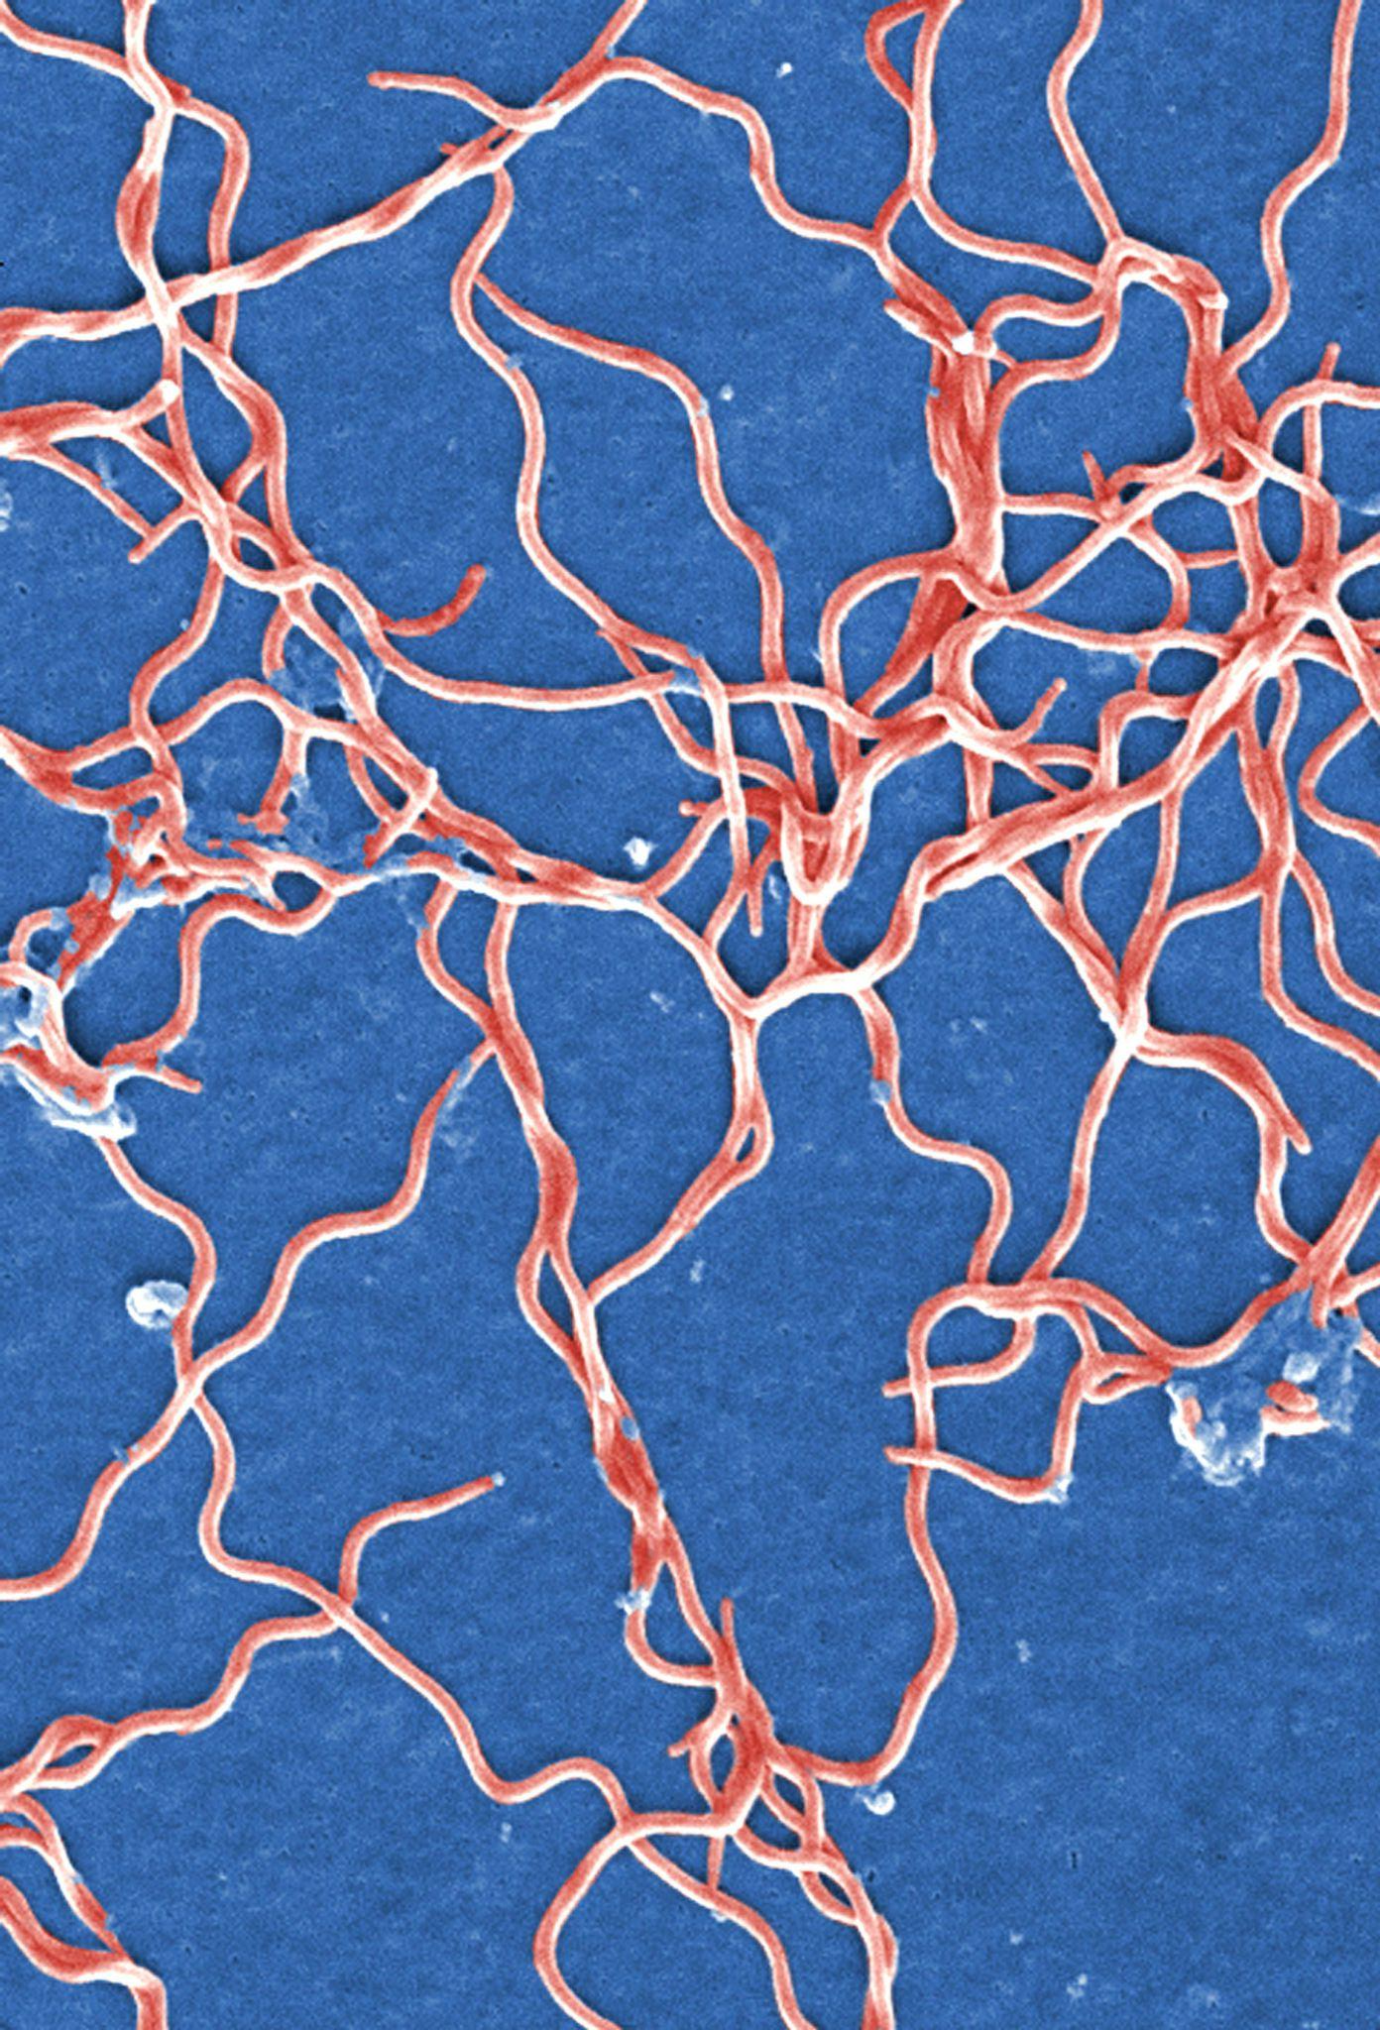
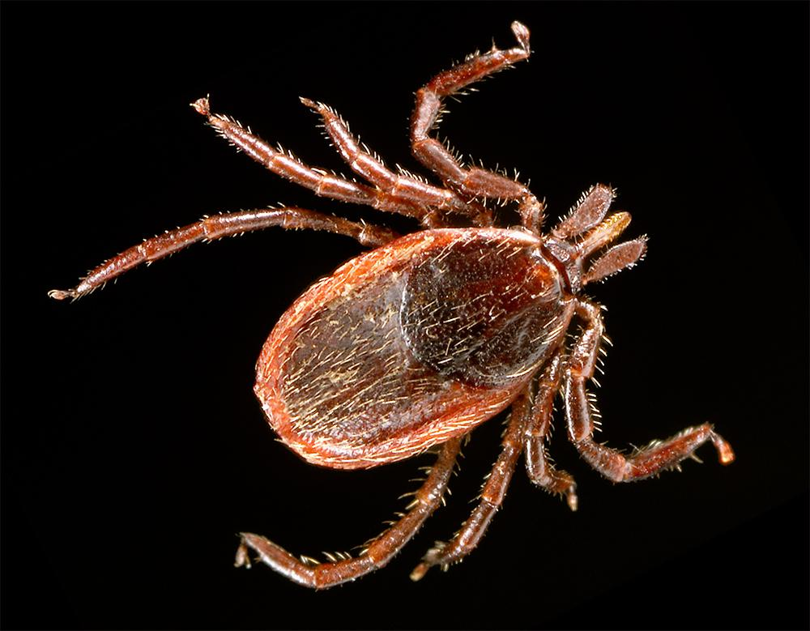
Lyme disease and Ixodes pacificus
Lyme is the most common tick-borne disease in the US
Lyme is spread by bites from ticks in the Ixodes genus that carry the Borrelia bacteria

Slide 35
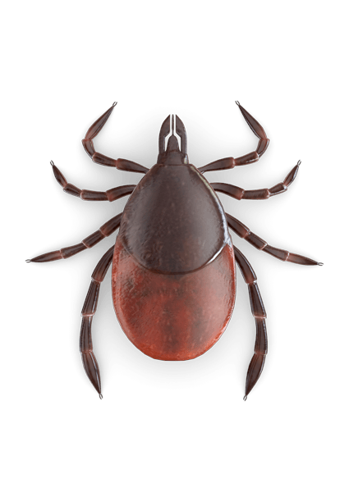
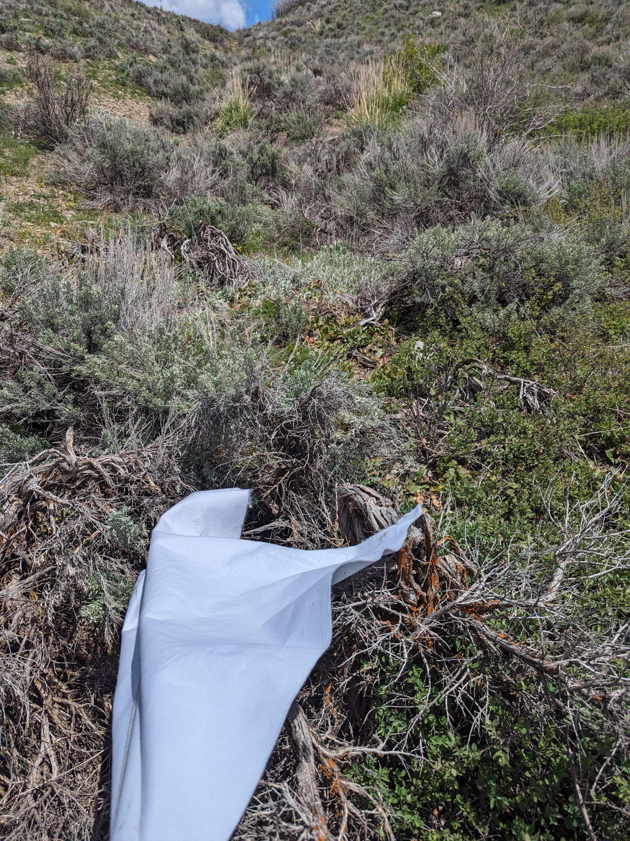
Can you get Lyme disease in Utah?
Ixodes pacificus ticks have been detected in Utah
Average of 17 Lyme cases per year in Utah
Very little historic state surveillance of ticks in Utah
Only one large-scale survey of ticks in Utah exists prior to 2021
USU study from 2011
Ixodes

Slide 36
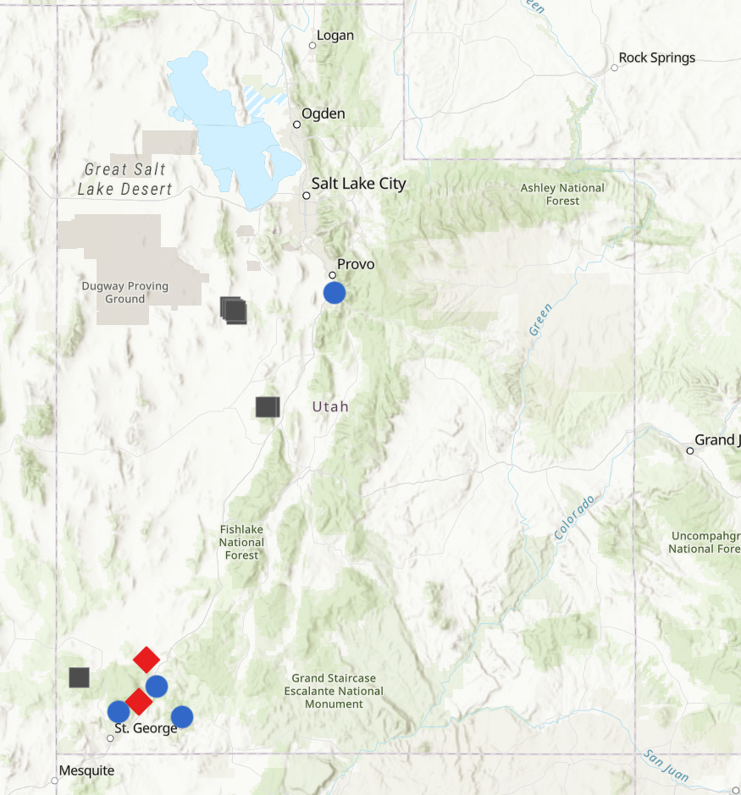
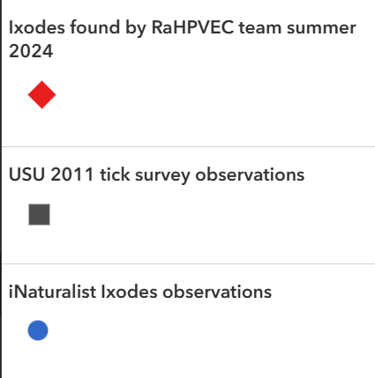
Ixodes in Utah,
with new data from summer 2024

Slide 37
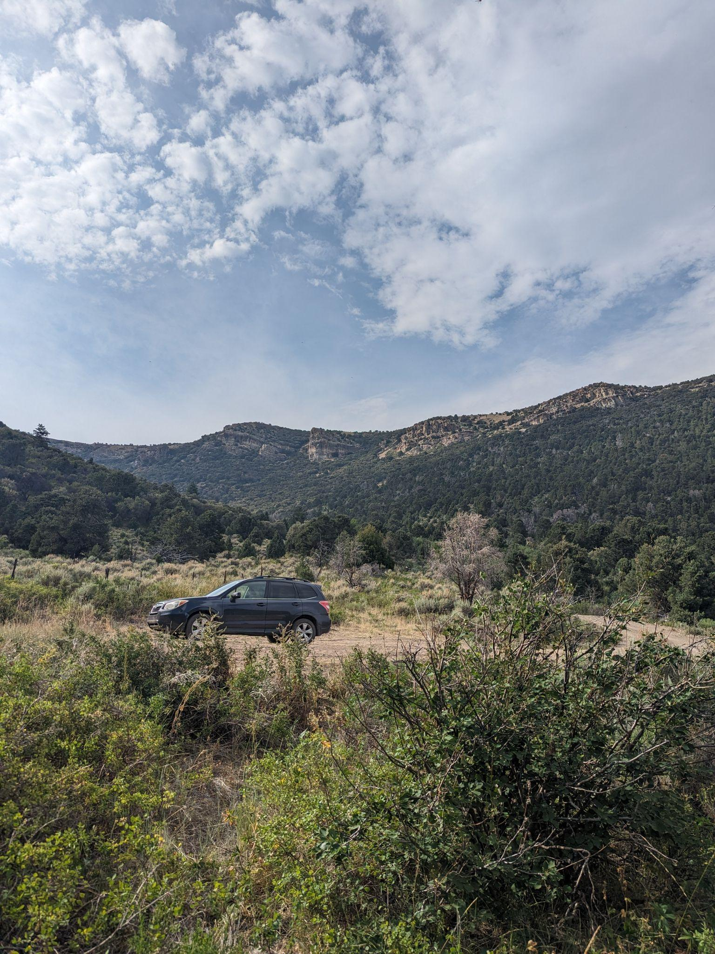
References
Ryan S. Davis, Ricardo A. Ramirez, J. Laine Anderson, Scott A. Bernhardt, Distribution and Habitat of Ixodes pacificus (Acari: Ixodidae) and Prevalence of Borrelia burgdorferi in Utah, Journal of Medical Entomology, Volume 52, Issue 6, November 2015, Pages 1361–1367, https://doi.org/10.1093/jme/tjv124
Ixodes pacificus photo credit: James Gathany, CDC Public Health Image Library
Borrelia burgdorferi photo credit: Janice Haney Carr, Claudia Molins, CDC Image Library

Slide 38
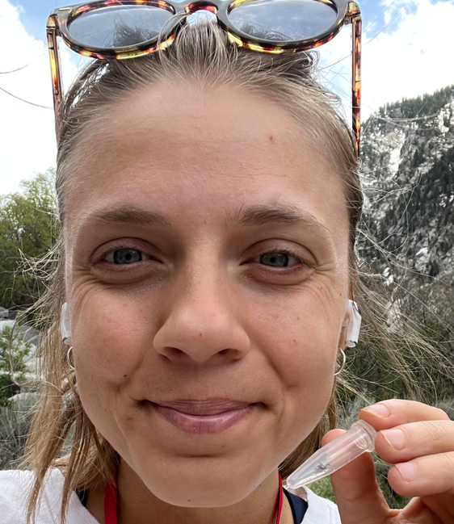
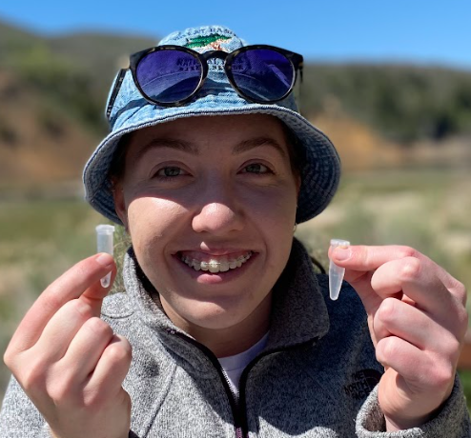
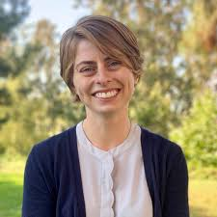
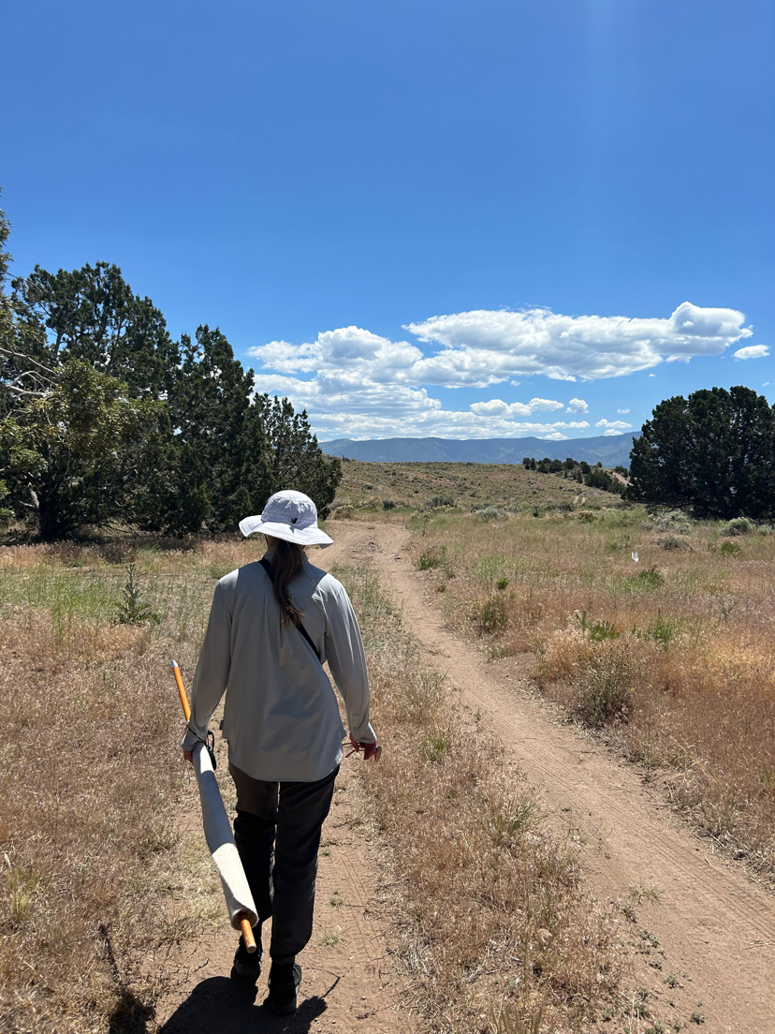
Special Thanks
Emily Johnston
Kacy Nowak
Karen Valcarce
Questions?
drewfreshour@gmail.com
Dr. Liz Hemming-Schroeder

Slide 39
Thank you!

Slide 40
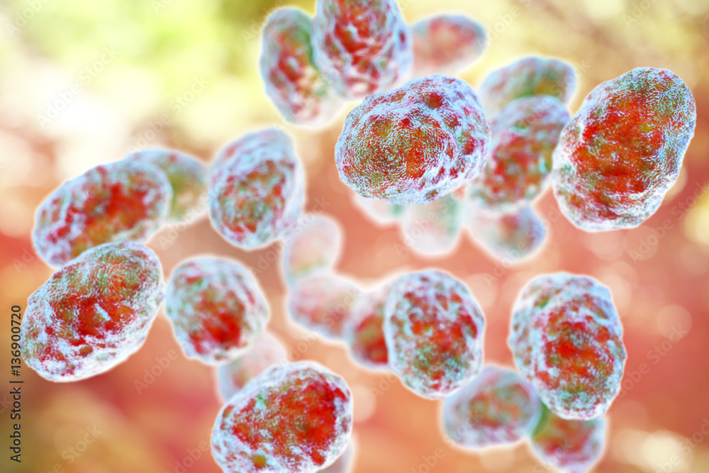
Environmental Assessment of Human Tularemia Cases in Cache County
Angie White, MS
Bear River Health Department

Slide 41
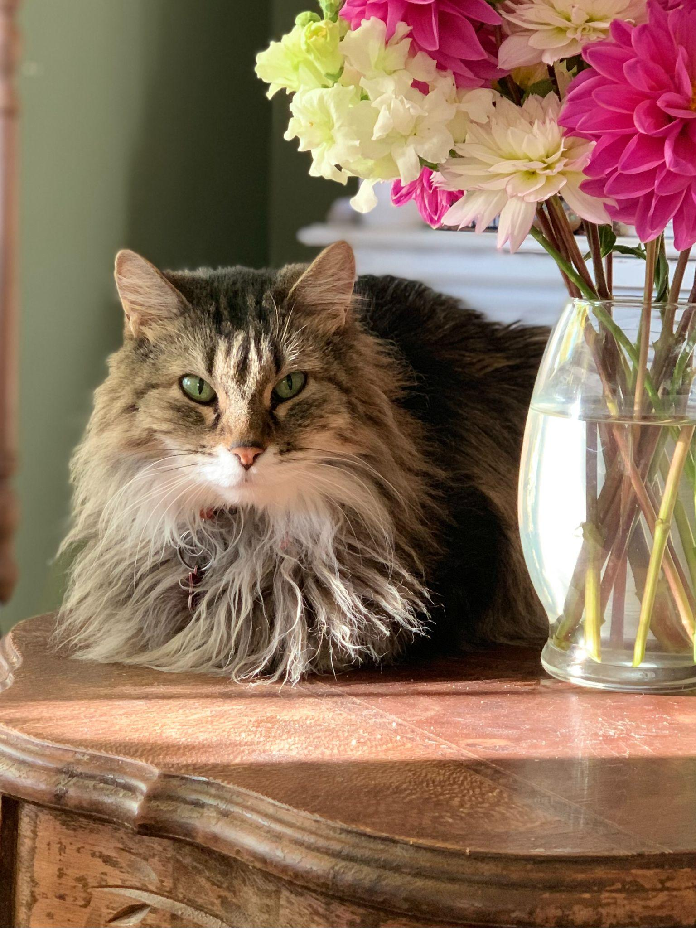
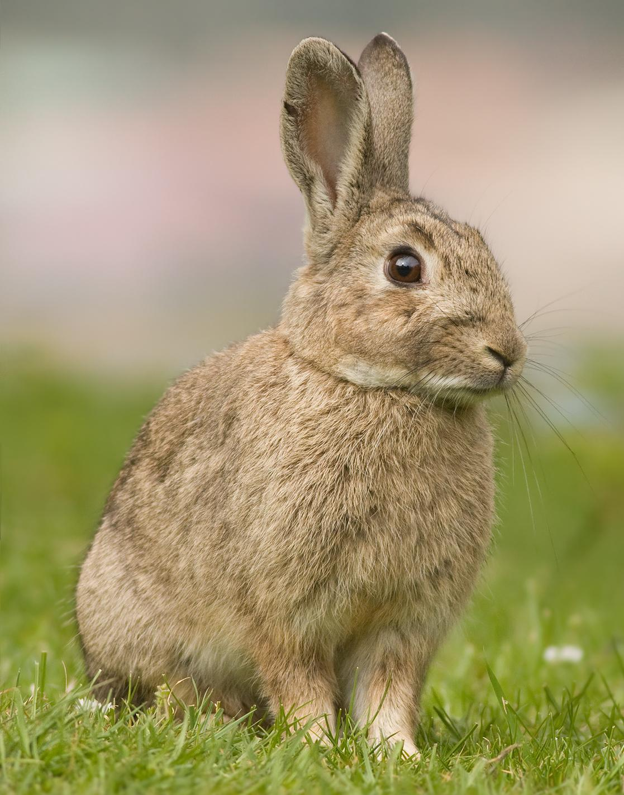
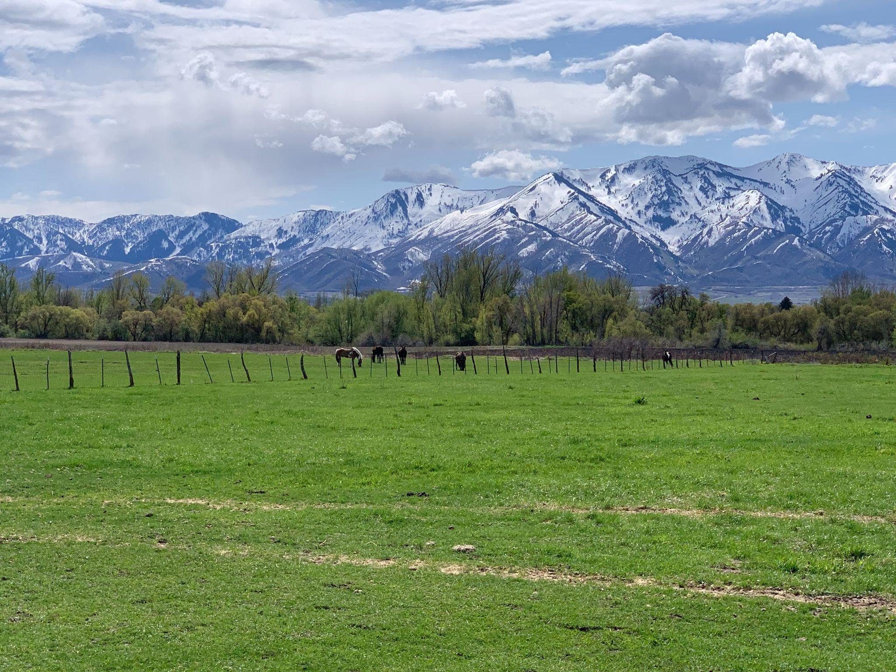
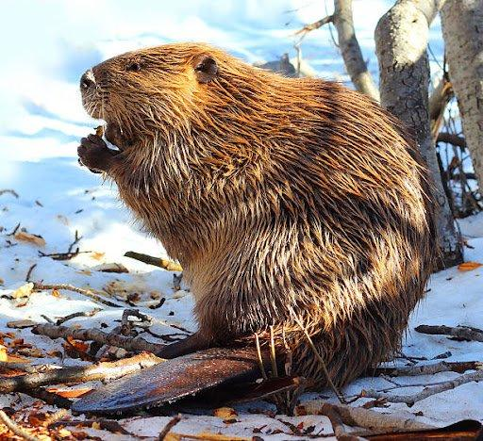
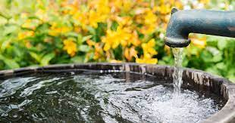
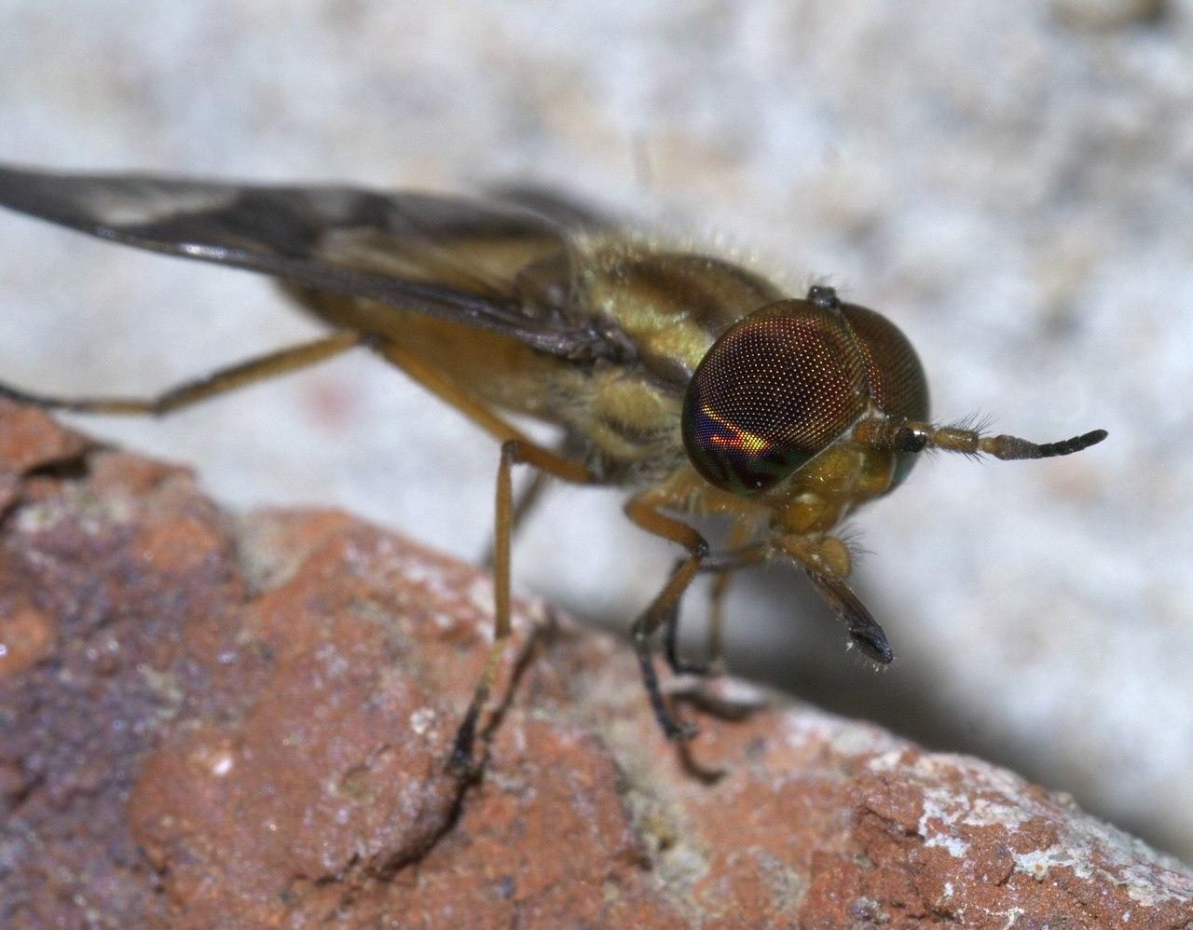

Slide 42
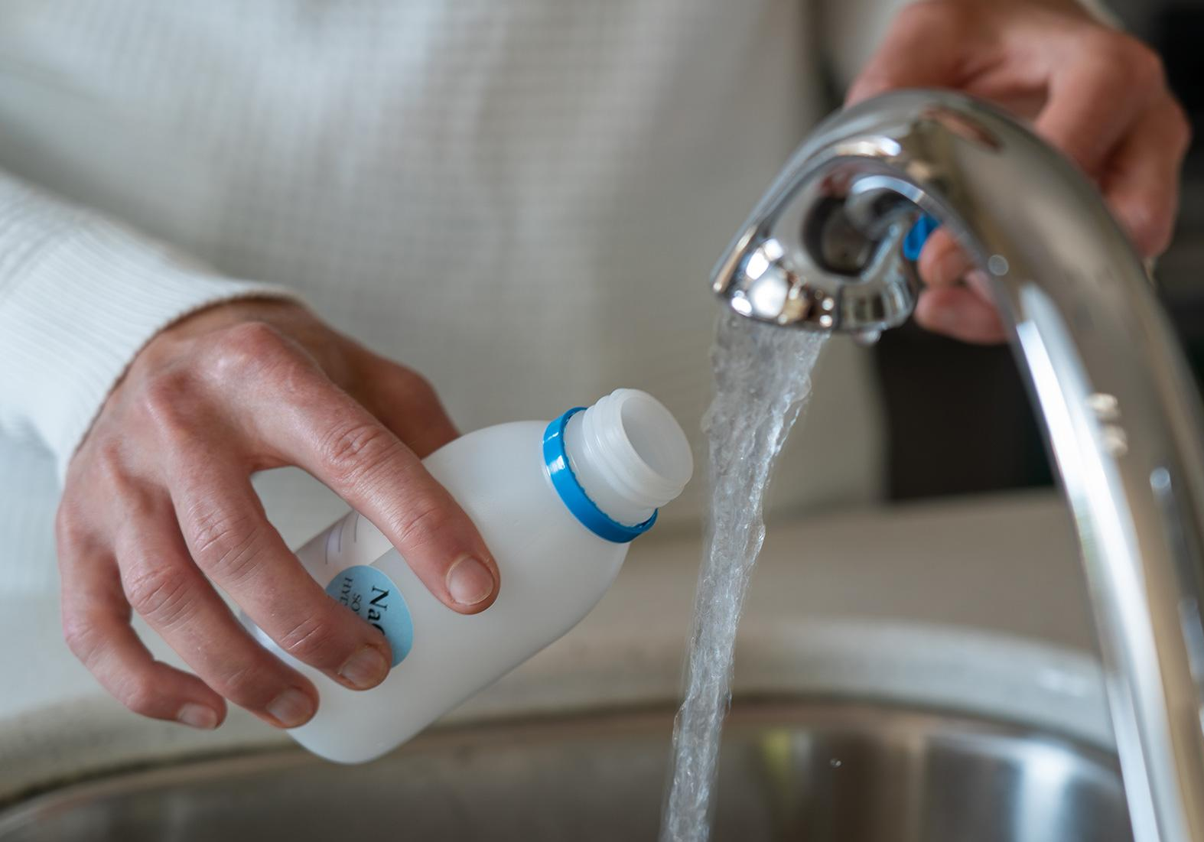
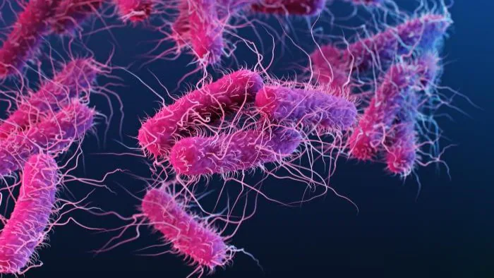
Sample ID | Sample Received Date | Collection Date | Analyte | A/P | Count (MPN)
242920 | 7/30/2024 | 7/30/2024 | 3100 - COLIFORM (TCR) | Present | 29.5
 |  |  | 3014 - E. COLI | Absent

Slide 43
We have completed testing of the large volume well water sample
(250 L) for molecular markers of F. tularensis and the human-specific fecal indicator, crAssphage. Neither F. tularensis nor crAssphage DNA were detected in the well water sample. Culturable coliforms and E. coli were detected at low levels in the well water (0.08 MPN/100 ml and 0.05 MPN/100 ml, respectively).
Together these data suggest ground water under the influence of surface water, either through site specific hydrogeology or through well structure failures or flooding.

Slide 44
A Tale of Tuleramia, Chapter 4
Explored by Erin Young, PhD
Utah Public Health Laboratory

Slide 45
Disclaimer:
Presenter has no conflicts of interest.
This presentation is designed to provide general information on sequencing attempts of F. tularensis at the Utah Public Health Laboratory (UPHL). This is not an endorsement from the State of Utah, APHL, StaPH-B, Karius, or any other organization. Any opinions expressed are strictly those of the presenter.
Any typos are the work of my cats.

Slide 46
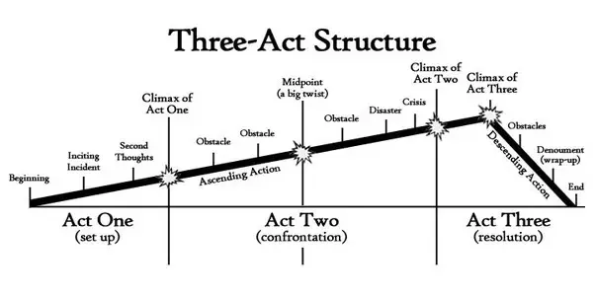
Where this would be in the plot

Slide 47
Where this would be in the plot

Slide 48
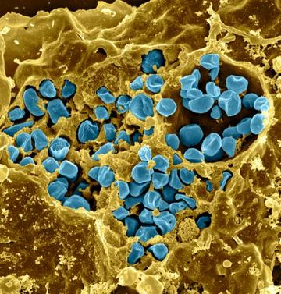
How “we” identify F. tularensis
There are several subtypes
tularensis (Type A)
Divided further into A I and A II
N. America
Most severe
holarctica (Type B)
Northern hemisphere
Not as severe
mediasiatica
Asia (not found in humans… yet)
novicida
Not always counted as a F. tularensis
Water
https://www.ncbi.nlm.nih.gov/datasets/taxonomy/263/

Slide 49
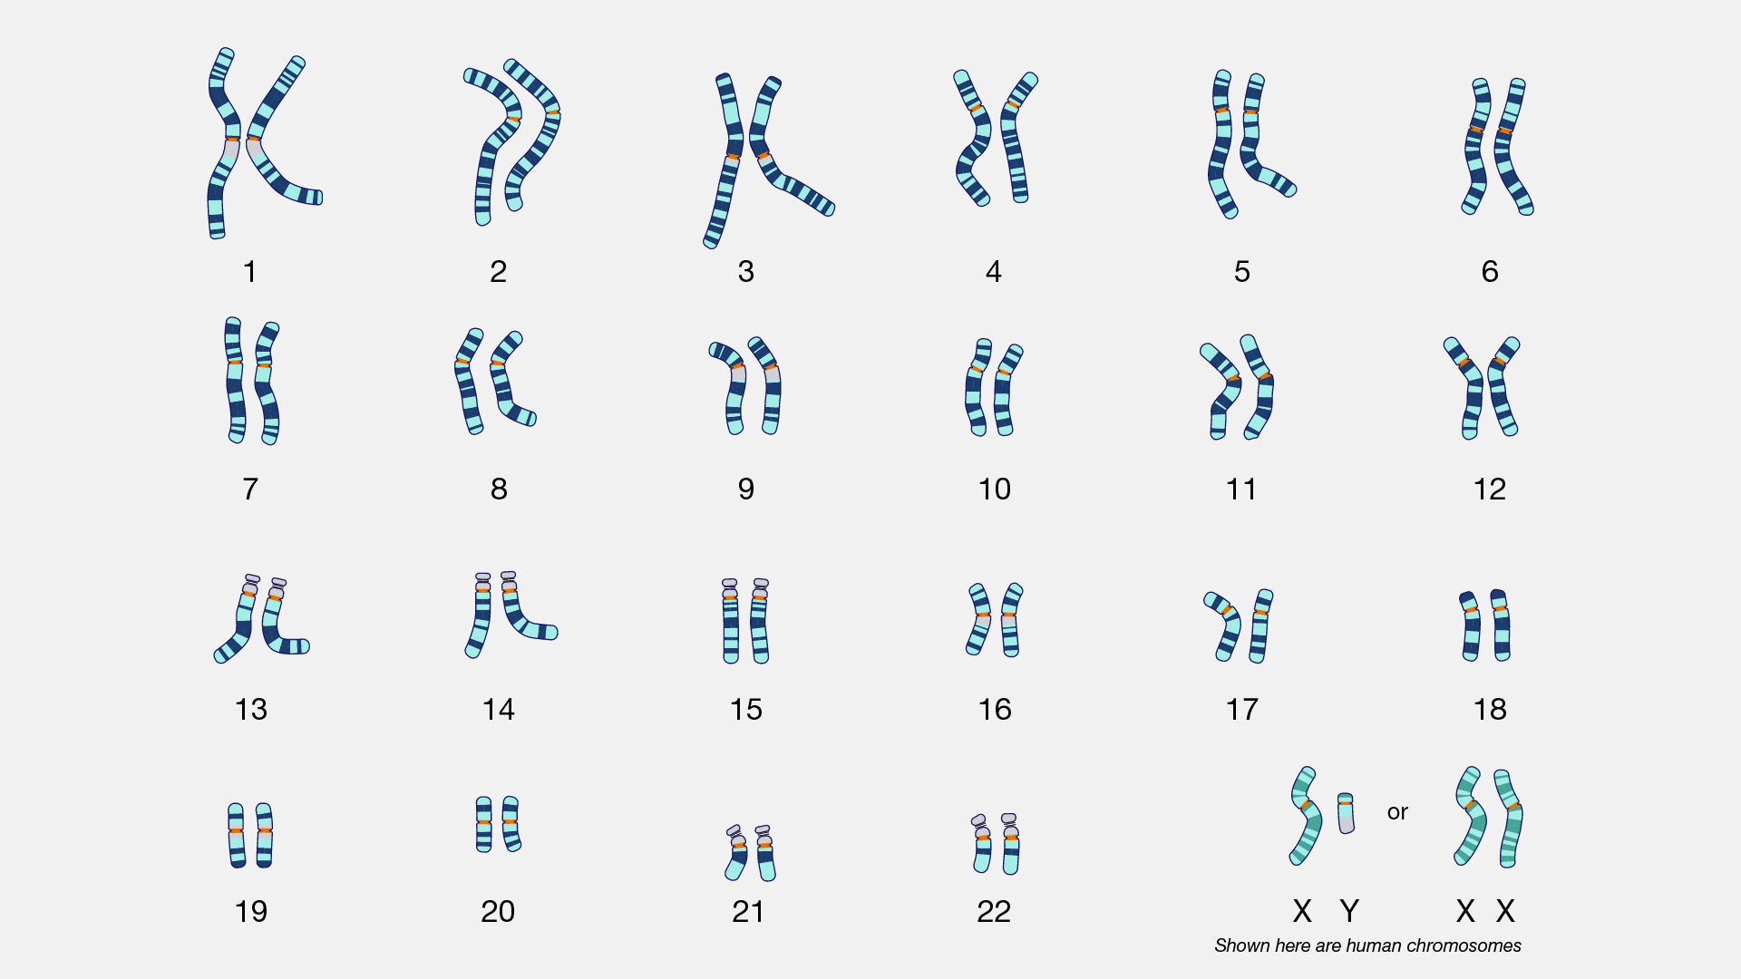
We can be identified through our DNA
https://www.businessinsider.com/guides/health/best-dna-kit ; https://www.genome.gov/genetics-glossary/Karyotype

Slide 50
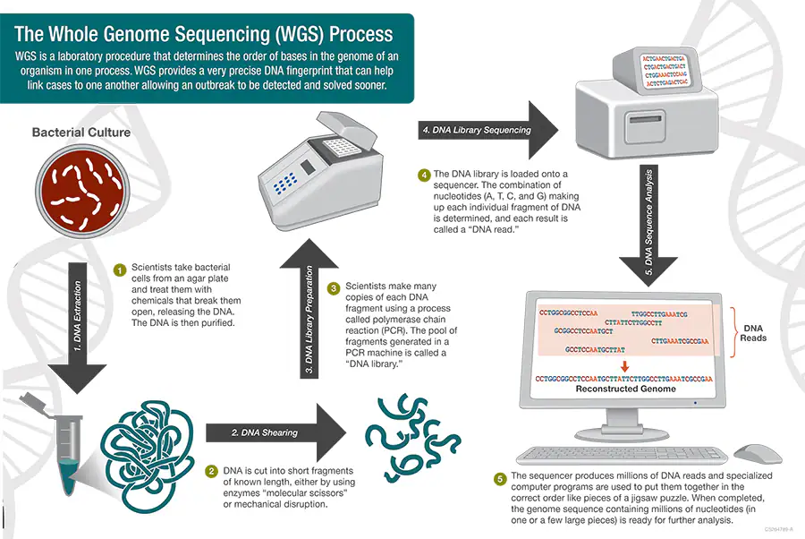
Bacteria can also be identified through their DNA
https://www.cdc.gov/pulsenet/php/wgs/index.html

Slide 51
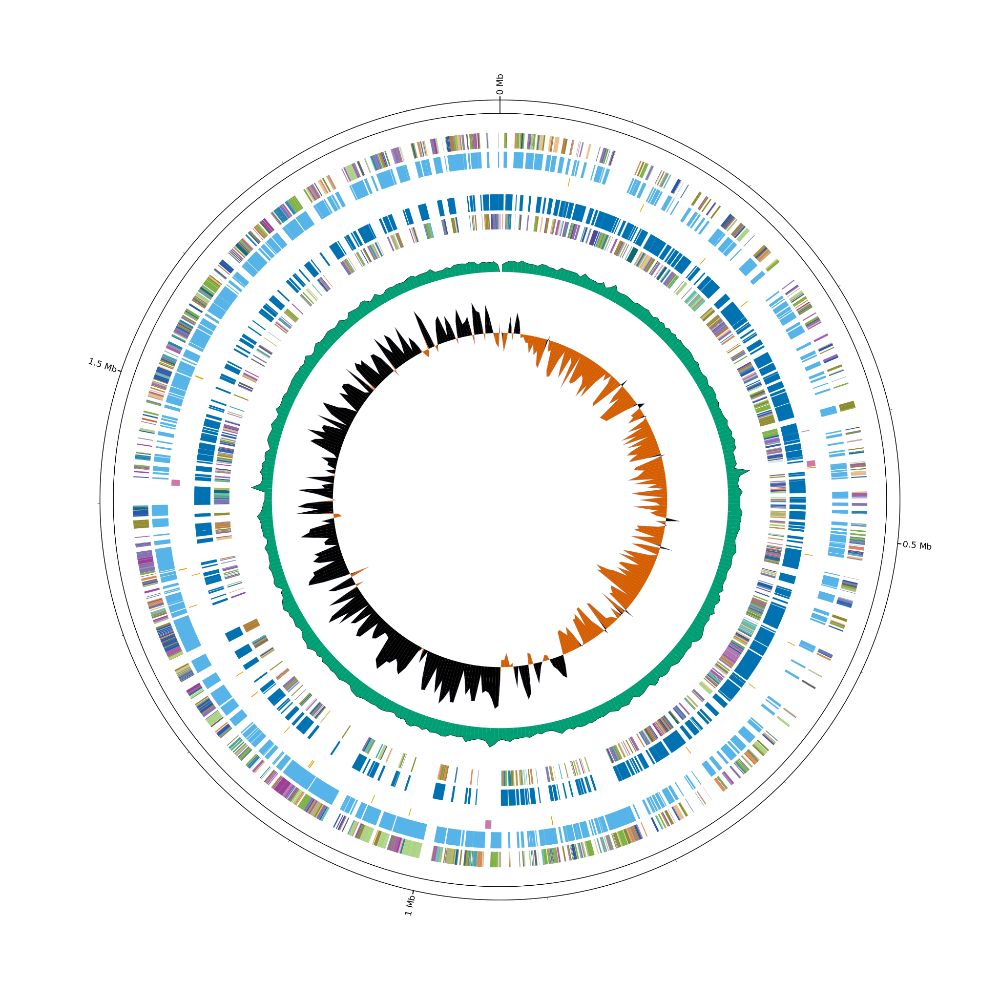
What can we do with bacterial DNA?
Subtype an organism
like subtype of F. tularensis
Identify relevant genes
like antimicrobial resistance genes
Compare genomes
like for an outbreak investigation
CDC has a walkthrough
on how sequencing is
used to improve public health at https://www.cdc.gov/advanced-molecular-detection/about/detecting-outbreaks.html
GCF_000833355.1 as visualized with genovi

Slide 52
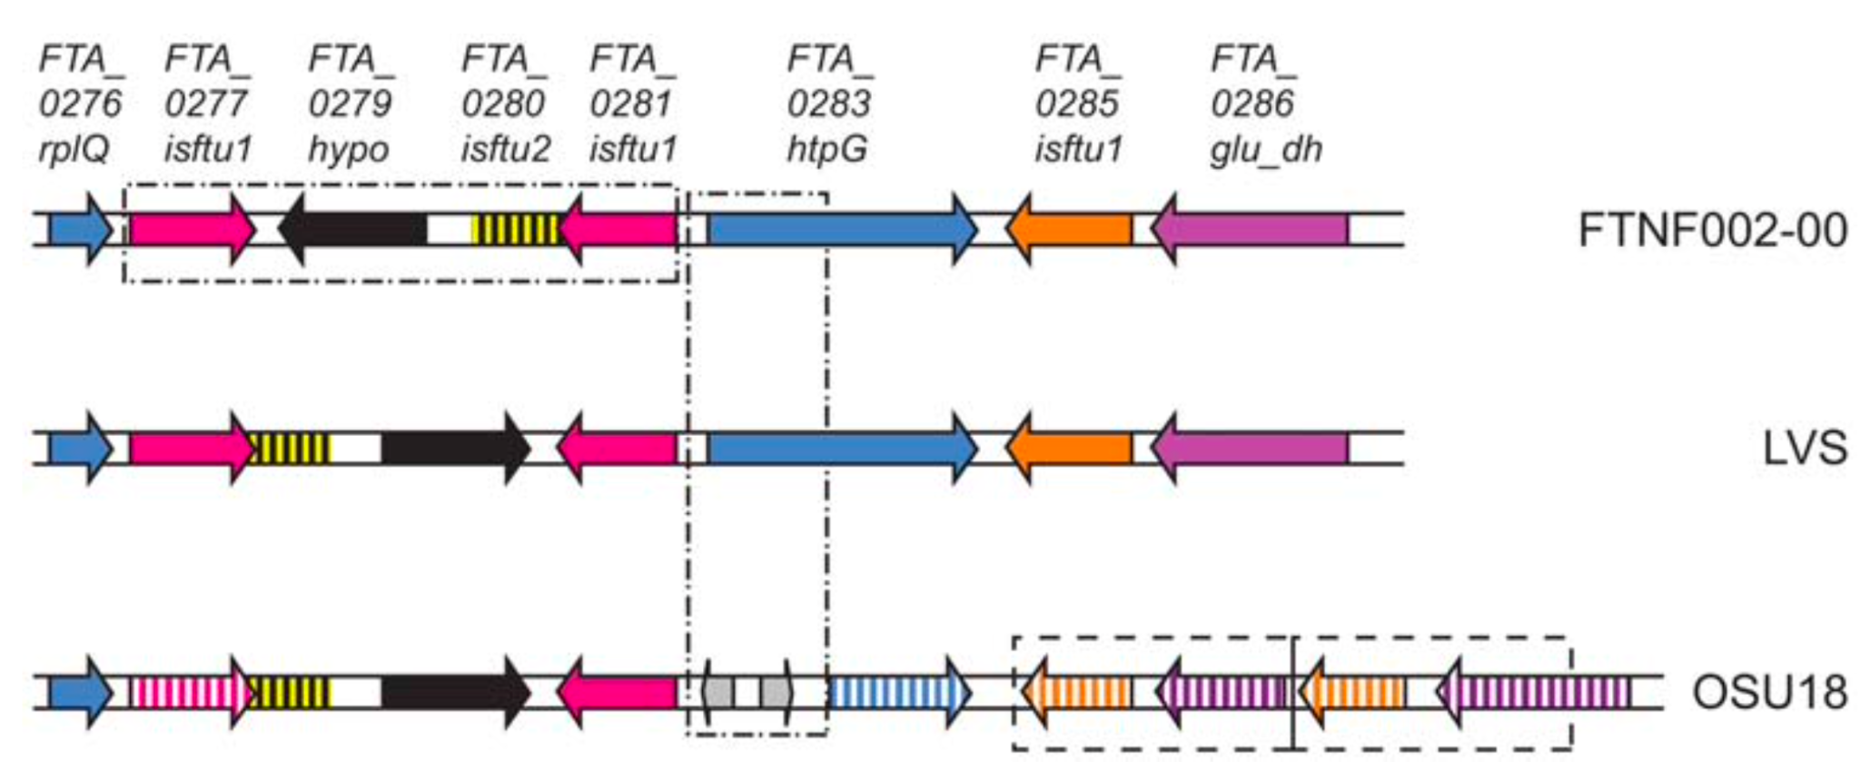
Existing gene rearrangements can distinguish lineages
Barabote et al. 2009

Slide 53
Sequencing F. tularensis would improve public health surveillance
https://www.cdc.gov/pulsenet/php/wgs/index.html

Slide 54
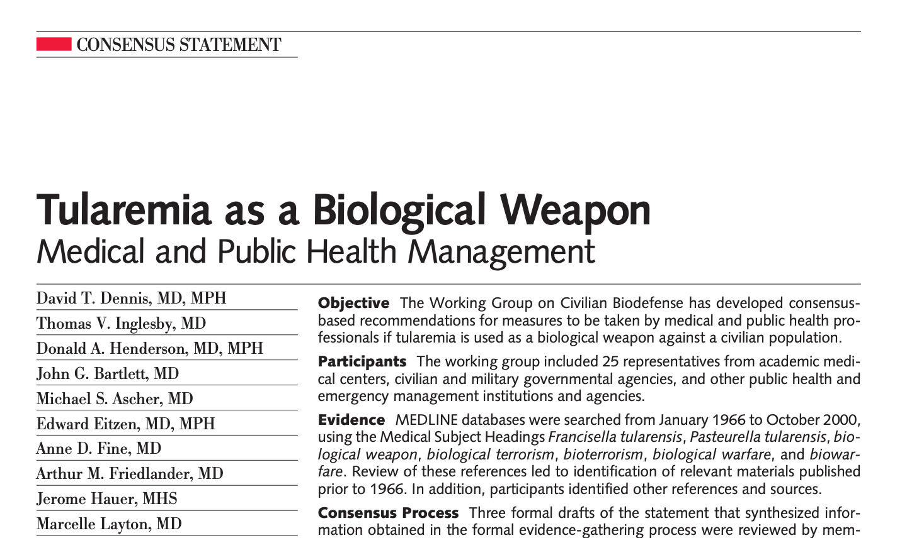
There are concerns of “lab leaks” with F. tularensis

Slide 55
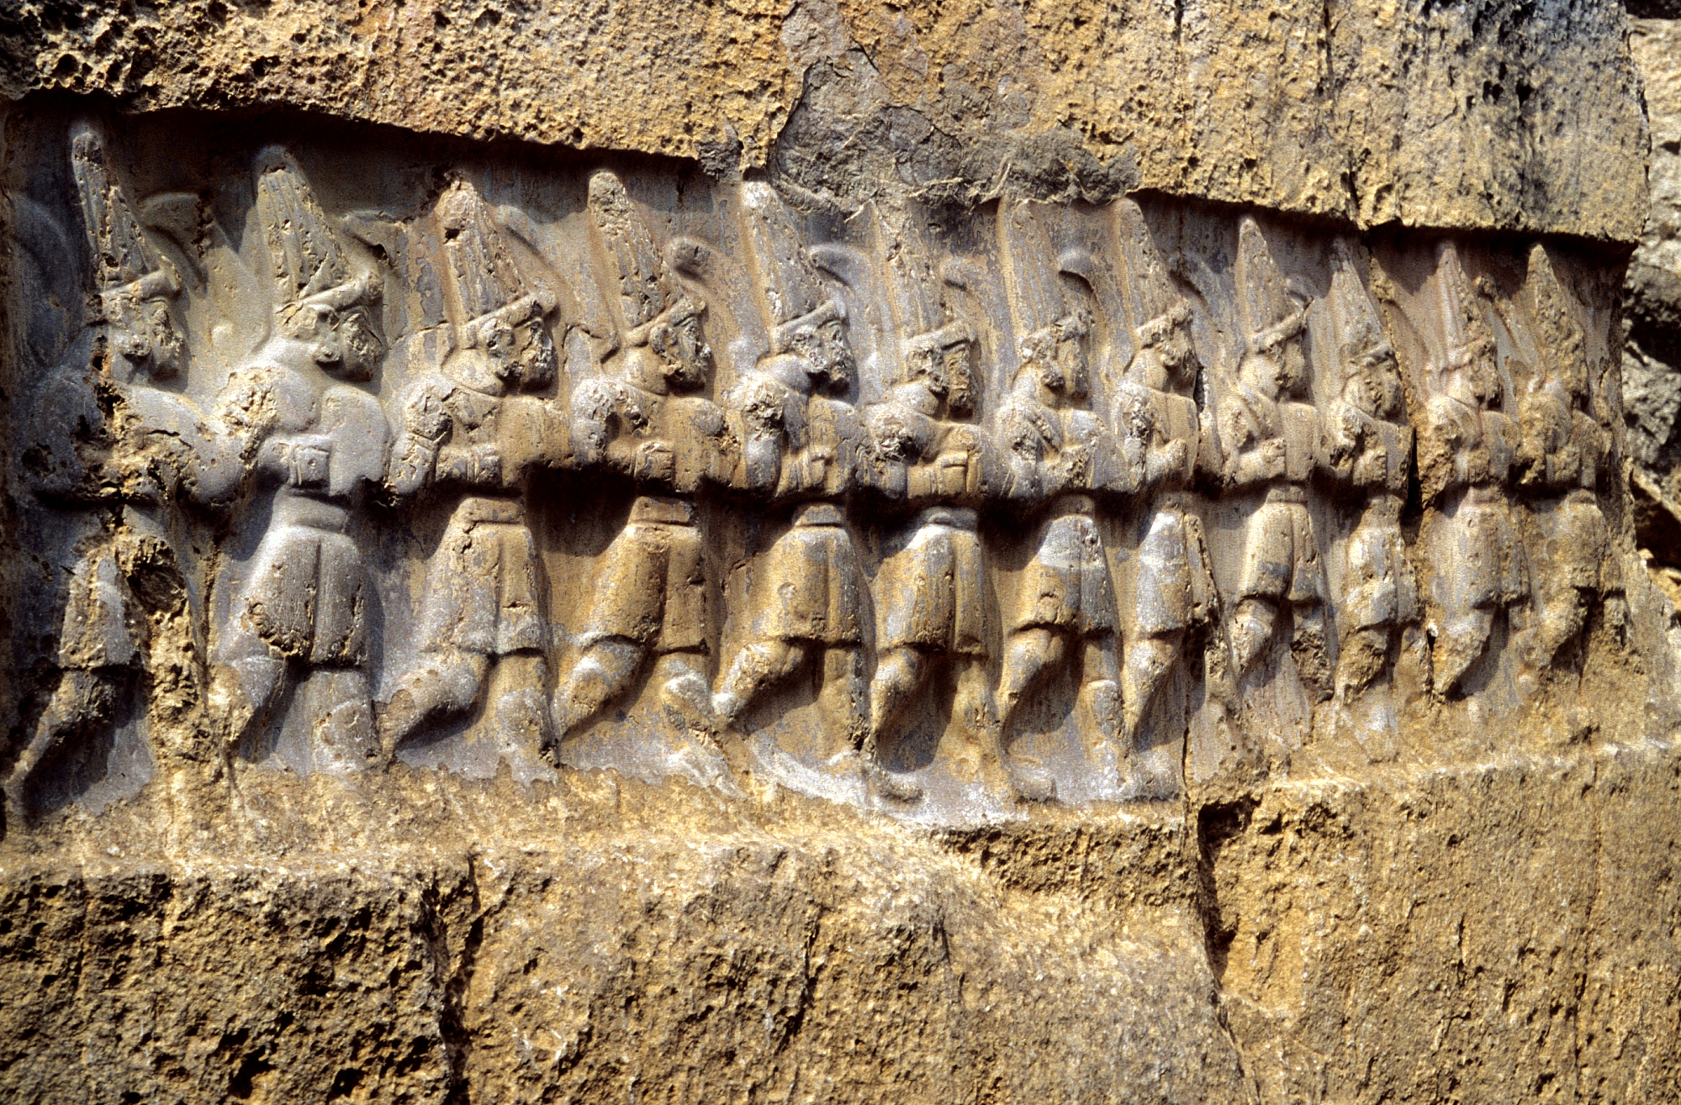
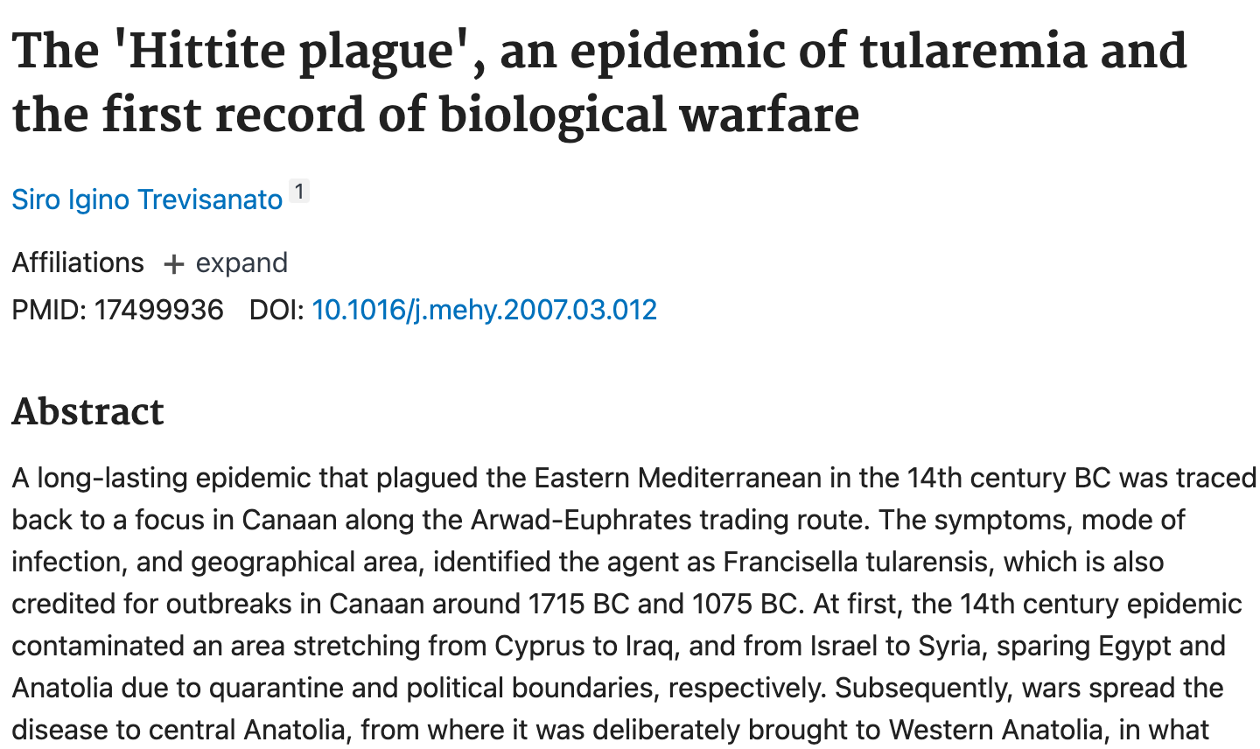
These aren’t unfounded safety precautions
https://en.wikipedia.org/wiki/Hittites

Slide 56
The laboratorians went to a simpler sequencing method
https://www.cdc.gov/pulsenet/php/wgs/index.html

Slide 57
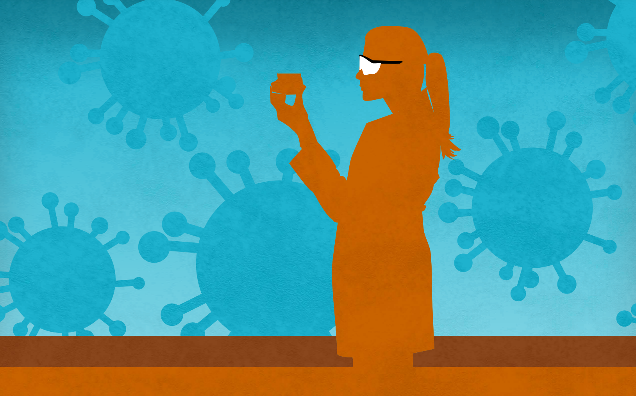
Getting sequencing at UPHL
Relevant people:
Clark Riddle
Courtney Freestone
Kimberly Christensen
John Hergert
Annette Atkinson
https://www.cdc.gov/advanced-molecular-detection/media/pdfs/posters/scientific-superhero-genome-sequencing-print-final.pdf

Slide 58
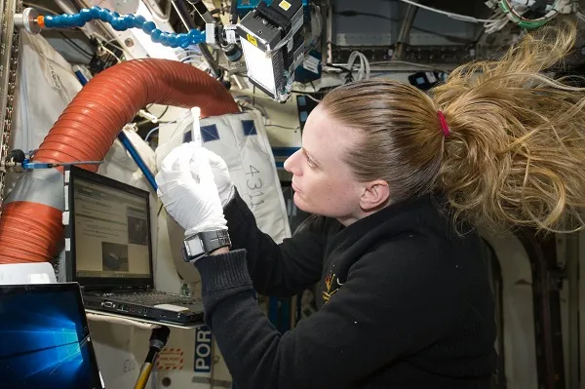
Nanopore sequencing can be done in space!
https://www.nasa.gov/missions/station/iss-research/dna-sequencing-in-space-timeline/

Slide 59
Nanopore sequencing can be done in space!
https://www.nasa.gov/missions/station/iss-research/dna-sequencing-in-space-timeline/

Slide 60
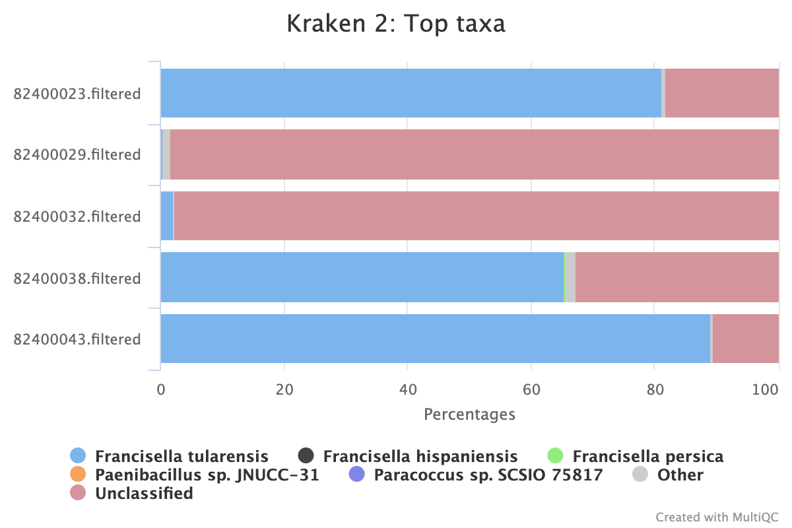
We were able to get some sequencing results

Slide 61
Where next?
Attempt a different extraction method
Current method:
Beaver collected by DWR
Black dots on liver
Extract DNA (must be sterilized through boiling)
Filtered
Smaller scope of information, such as PCR
More cases are expected to come

Slide 62
Questions?
GCF_000833355.1 as visualized with genovi
https://www.ncbi.nlm.nih.gov/datasets/taxonomy/263/

Slide 63
Patient and animal samples are consistent with F. tularensis subsp. holarctica
subsp. mediastiatica
average adjusted identity
subsp. novicida
subsp. tularensis (type A)
subsp. holarctica (type B)
KT
KT
subsp. holarctica (type B)
KT
subsp. tularensis (type A)
KT
genome assemblies
There is genetic similarity between the animal samples and an unrelated UT patient sample (Jan 2023). This is consistent with lower genetic diversity within subsp. holarctica (at least in Utah).

Slide 64
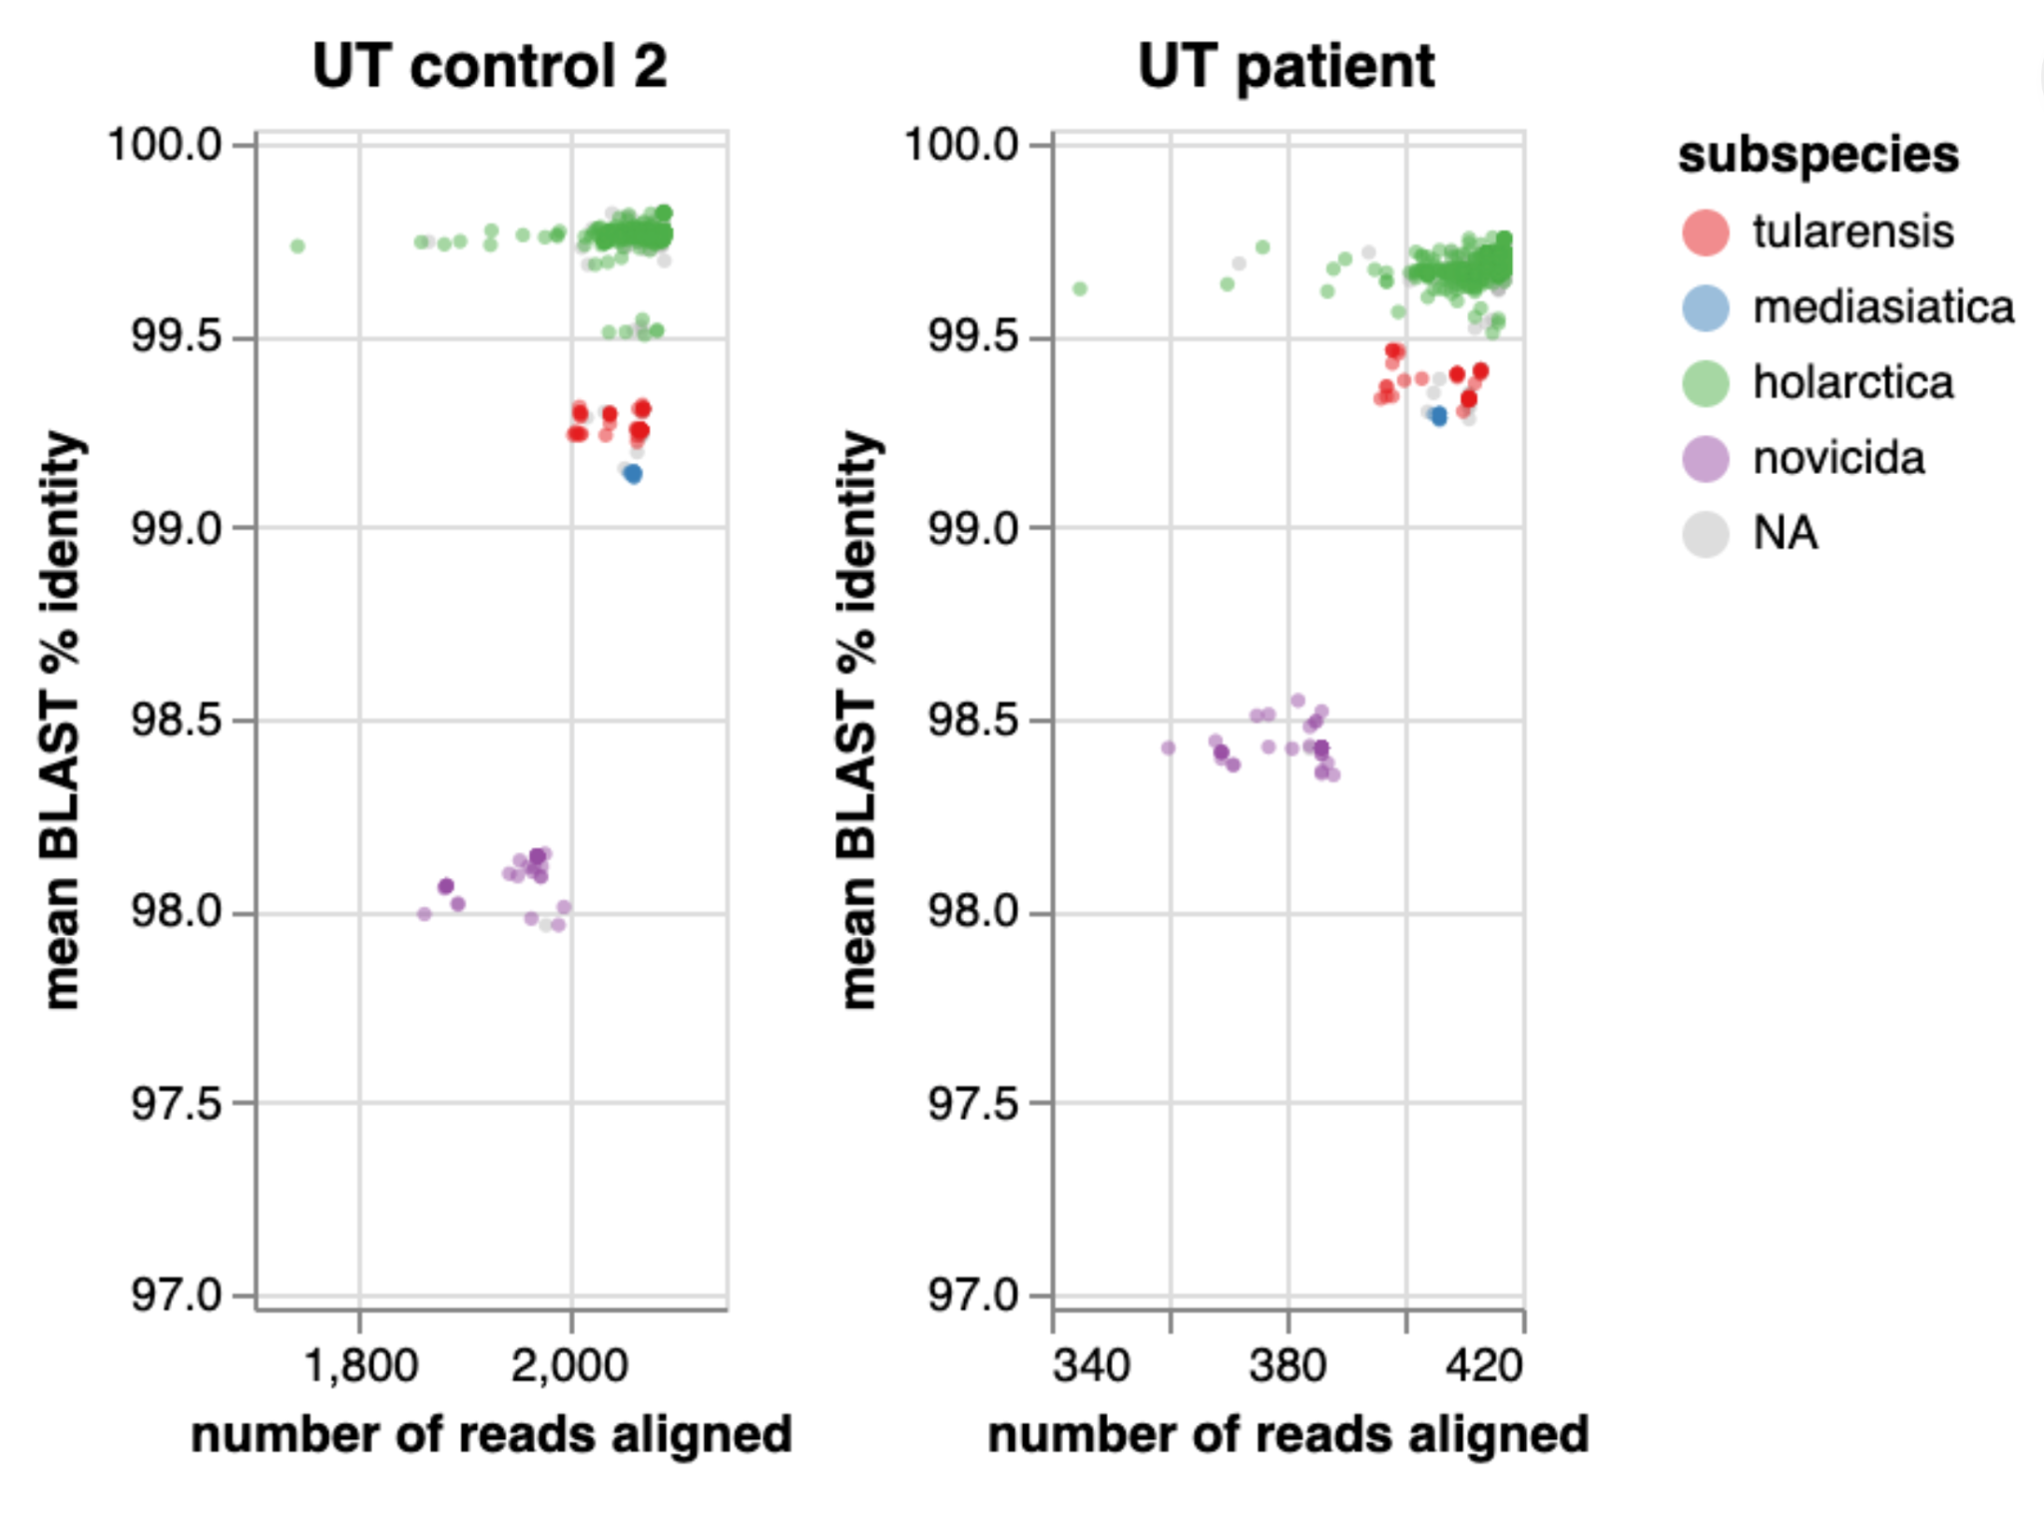
Further analysis may support finer resolution within subsp. holarctica
KT
KT
There are some differences among the Karius samples within each subspecies.
Further analysis may allow finer resolution within subspecies.
Unadjusted mean percent identity is shown.

Slide 65
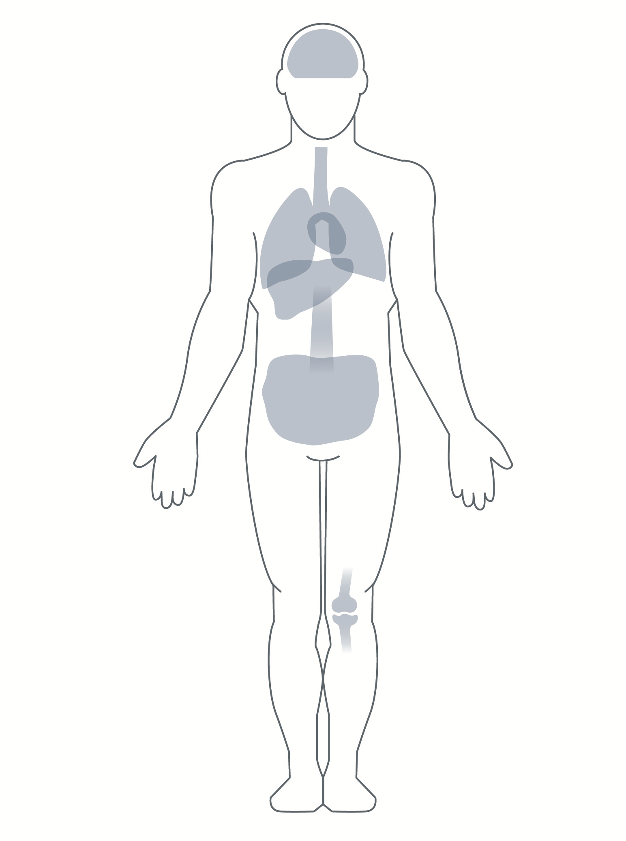
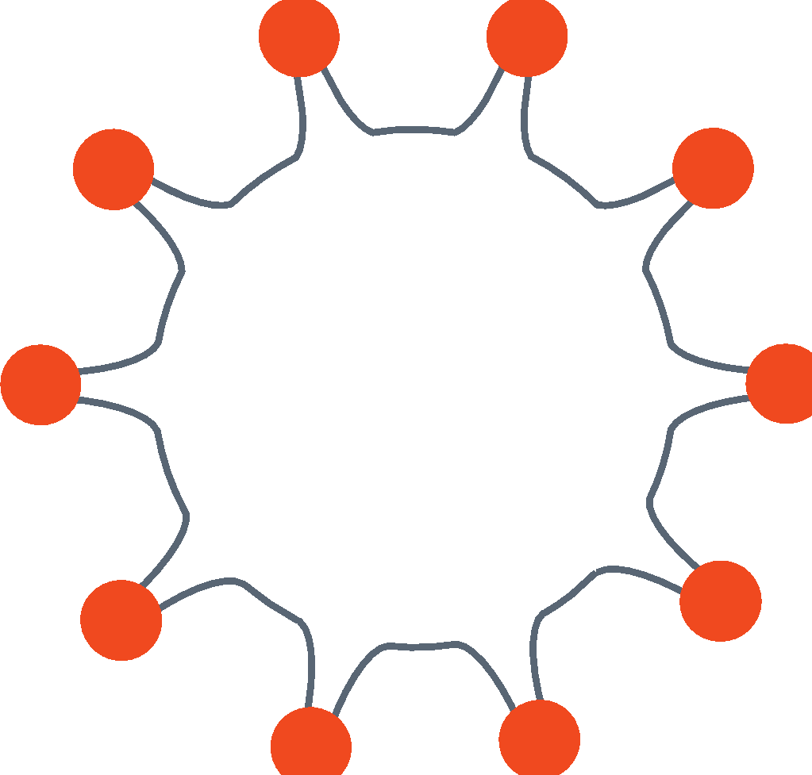
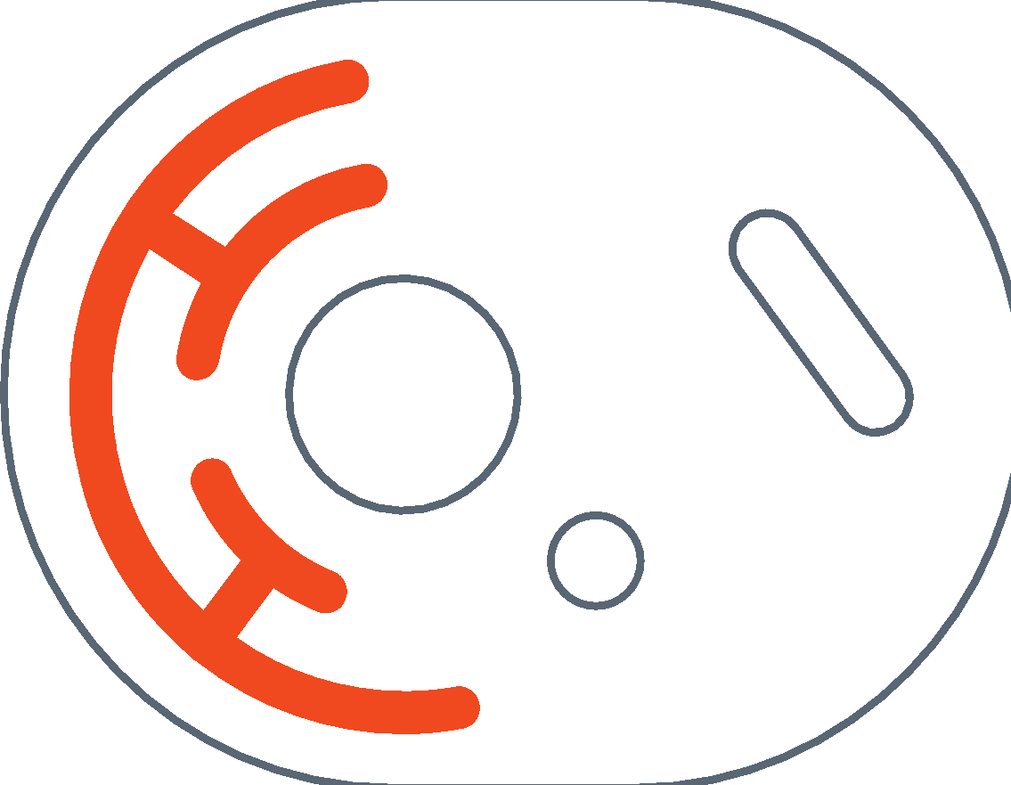
Plasma Microbial Cell-Free DNA (mcfDNA) Metagenomic Sequencing
Bacteria
CELL-FREE DNA IN PLASMA
Fetal DNA 10%
Tumor DNA ~0.1%
Microbial DNA 0.001%
DNA Viruses
Fungi
5 ml Blood
PPT Tube
Parasites
1. Blauwkamp, T. A. et al. Nat.Microbiol. 4, 663–674 (2019)
2. Hu, P., Liang, D., Chen, Y. et al. J. Transl Med. 17, 124 (2019)
3. Volik, S. et al. Mol. Cancer Res. 14, 898–908 (2016)

Slide 66
Laboratory Process*
CAP Accredited and CLIA Certified Lab
5 ml PPT tube pre-spun and shipped at ambient temperature in provided collection kit or ≥1.2 ml plasma from K2 EDTA draw in sterile pour-off tube
Receipt at lab ≤96 hours after blood collection
Automated DNA extraction and NGS library prep protocols optimized for low bias and high speed
Controls for carry over, bias, NGS quality, mix-ups, and quantitation added on receipt
Microbial cfDNA 10⁶ times less abundant than human cfDNA; Karius developed proprietary protocols to enrich mcfDNA
Single-end 75-base sequencing on NextSeq 500
Average >20 million reads/sample
Sequences mapped to >20,000 clinical-grade references to report ~1,000 clinically relevant bacteria, DNA viruses, fungi, and parasites
Median time from sample collection to delivery of reported result 63 h (IQR 49 to 89)
*CLIA-certified, CAP-accredited, NY State approved reference laboratory in Redwood City, CA
Park et al. J Clin Microbiol. 2023 Aug 23;61(8)
Nolte. Today’s Clinical Lab. Dec 18, 2023

