Slide 1
A TALE OF TWO APPROACHES: IMPROVING THE IMPLEMENTATION OF MASS RABIES POST-EXPOSURE PROPHYLAXIS IN UTAH, 2024
LT Amelia Johnson
DrPH, MPH
Epidemic Intelligence Service Officer
CDC, Utah DHHS

Slide 2
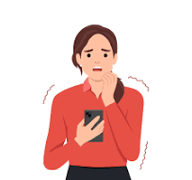
Notes:
On July 3, 2024, concerned parents of children in a church youth group that had stayed at a camp in Idaho…

Slide 3
Notes:
contacted a local health department (which I’ll call HD1) and Utah DHHS to report

Slide 4
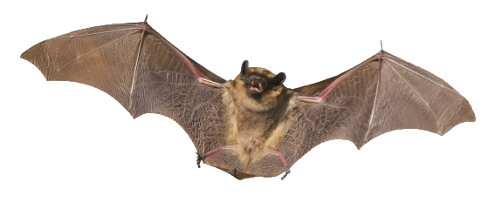
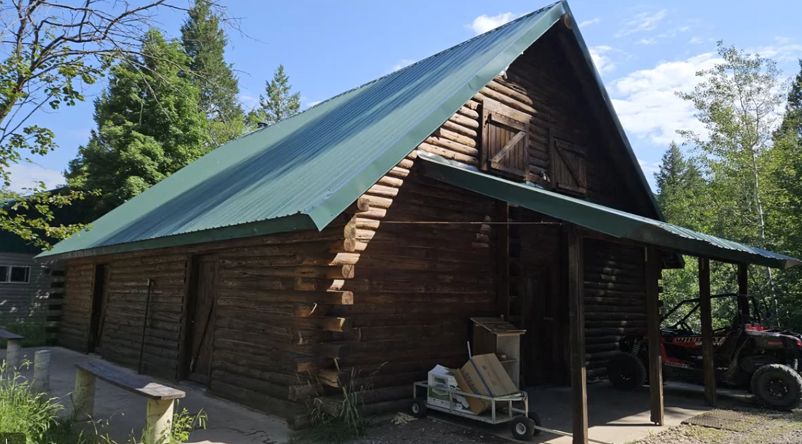
Notes:
their children had slept in a cabin that was infested with bats.
The concern was that these campers may have been exposed to rabies through a bite or scratch from an infected bat, while sleeping.

Slide 5
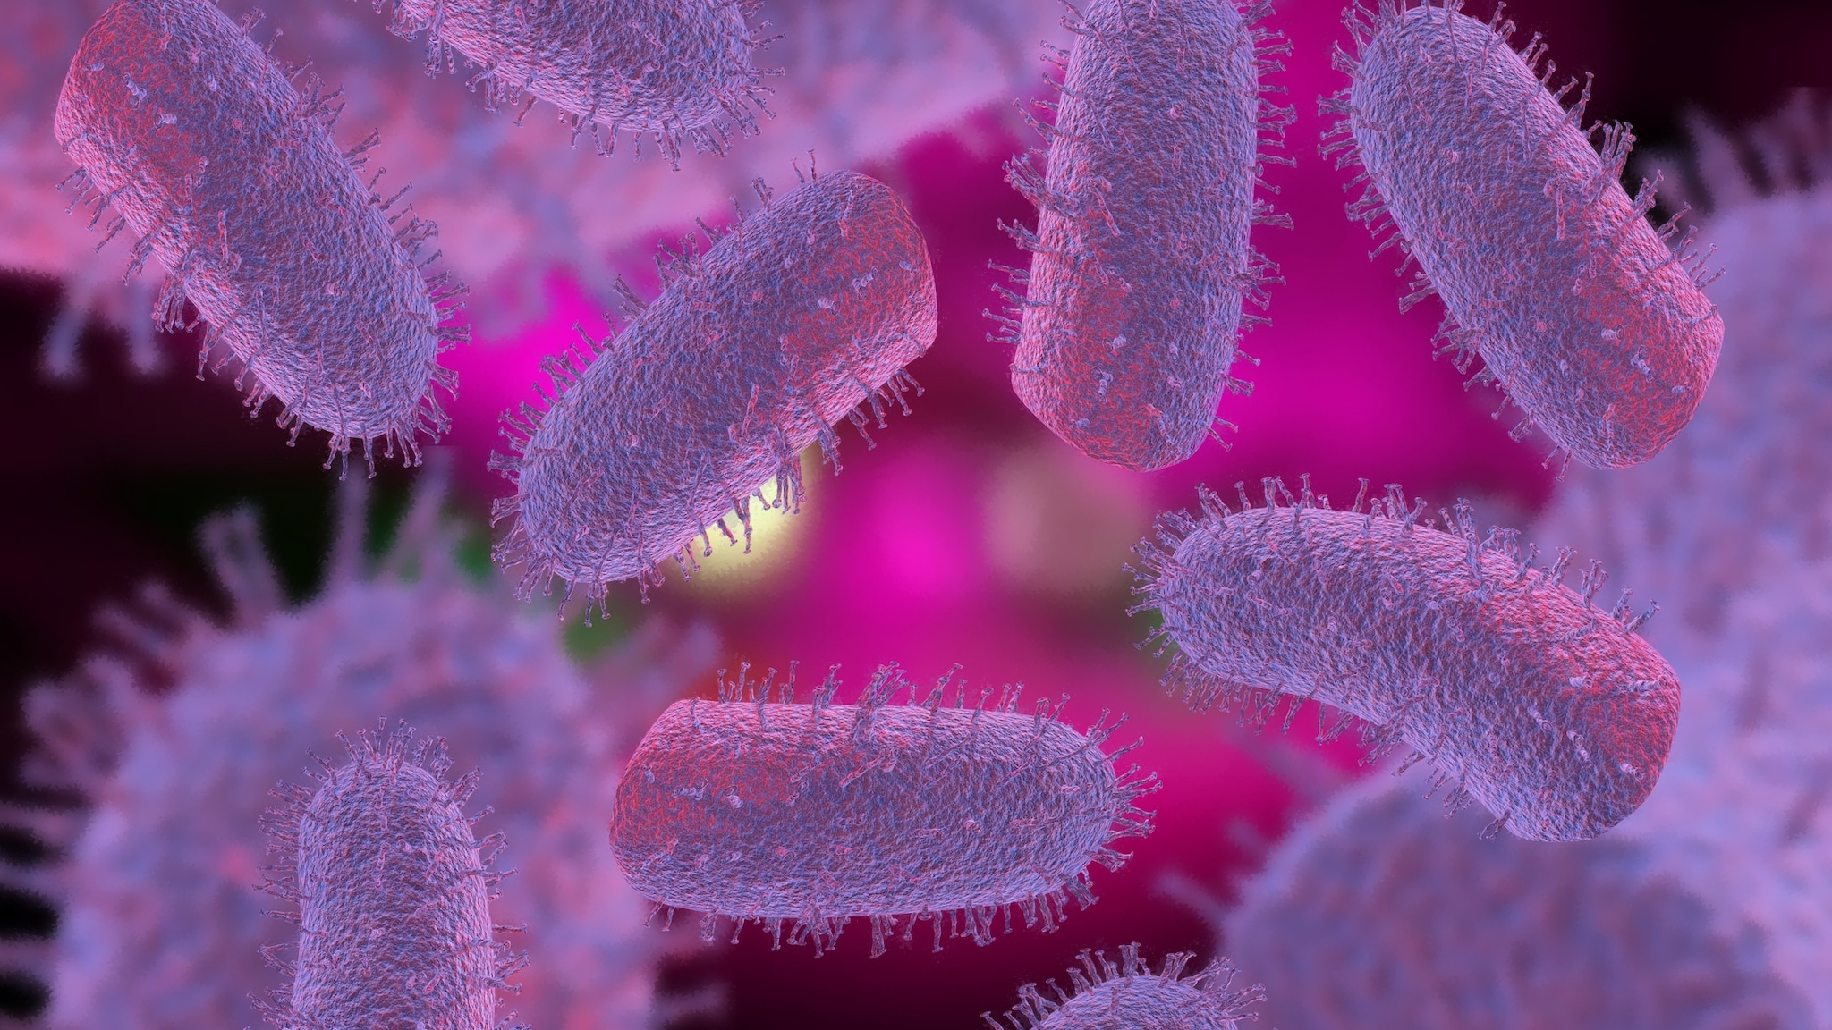
Rabies
Notes:
Rabies is caused by a virus that spreads to animals and humans through contact with an infected animal’s saliva, usually through a bite or scratch.

Slide 6
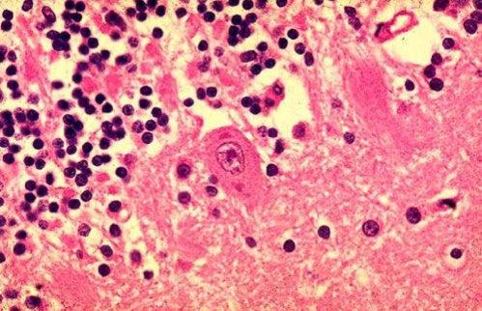
Rabies
Notes:
It’s nearly 100% fatal once the virus infects the central nervous system and clinical symptoms appear.

Slide 7
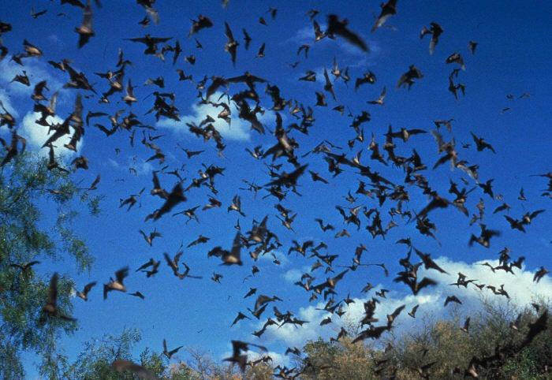
Rabies
Notes:
In Utah, rabies is primarily spread by bats.

Slide 8
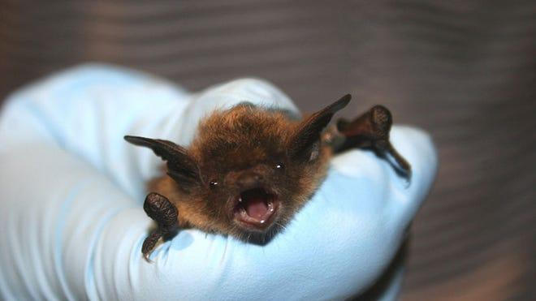
Rabies
Notes:
The problem is, a bat bite may not be noticeable because their teeth are so small. Therefore, a sleeping person may not realize they’ve been bitten.

Slide 9
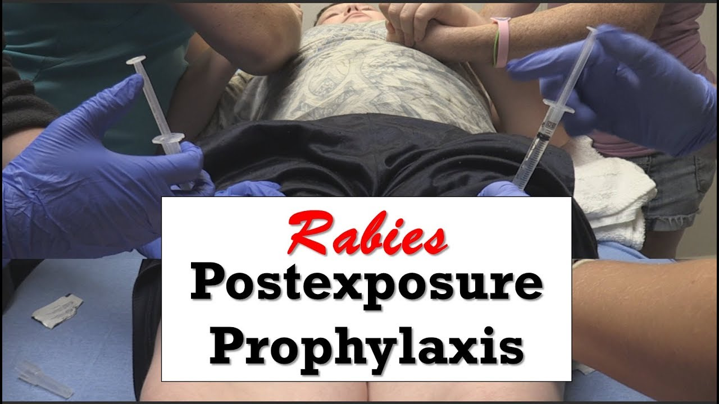
Rabies
Notes:
Following exposure, there’s still an opportunity to prevent infection through the administration of rabies postexposure prophylaxis, or PEP.

Slide 10
MASS RABIES PEP ADMINISTRATION TIMELINE
4th of July
July 1
Group 1 exposure
Notes:
Now, back to our story’s timeline. Campers in group one had slept in the cabin starting July 1.

Slide 11
MASS RABIES PEP ADMINISTRATION TIMELINE
4th of July
July 1
July 3
Group 1 exposure
HD1 notification
Notes:
HD1 and DHHS responded rapidly to contact all potentially exposed campers, inform them of their exposure risk and treatment recommendations, and organize rabies PEP administration.

Slide 12
MASS RABIES PEP ADMINISTRATION TIMELINE
4th of July
July 5
July 1
July 3
Group 1 exposure
HD1 notification
HD1 rPEP clinic
Notes:
Supplies of PEP in emergency departments nearby were too low to support the large number of exposed campers. Therefore, HD1 decided to organize a health department led clinic on July 5

Slide 13
HD1 RESPONSE
30 campers recommended to receive rPEP in UT
1 camper declined
29 campers began and completed PEP
Notes:
All in all, HD1 recommended PEP for 30 campers. 29 campers began and finished their PEP series.

Slide 14
HD1 RESPONSE
30 campers recommended to receive rPEP in UT
1 camper declined
29 campers began and completed PEP
HD clinic organized for administration of all rPEP
Notes:
HD1 administered the full series for all 29 campers at their clinic.

Slide 15
HD1 RESPONSE
30 campers recommended to receive rPEP in UT
1 camper declined
29 campers began and completed PEP
HD clinic organized for administration of all rPEP
Emergency order for rPEP (HRIG and vaccine) from Cardinal Health supplier
Funded through DHHS
Upfront PEP costs were $2,931 per camper
Notes:
And they were able to place an emergency order with Cardinal Health, using state funding, for the full supply of PEP. HD1 spent about $2900 per camper.

Slide 16
MASS RABIES PEP ADMINISTRATION TIMELINE
4th of July
July 5
July 1
July 3
Group 1 exposure
HD1 notification
HD1 rPEP clinic
Notes:
Back to our timeline.

Slide 17
MASS RABIES PEP ADMINISTRATION TIMELINE
4th of July
July 5
July 7
July 1
July 3
Group 1 exposure
HD1 notification
HD1 rPEP clinic
HD2 notification
Notes:
That weekend, a separate health department, HD2, was notified of a second group of church youth campers that had slept in the same cabin,...

Slide 18
MASS RABIES PEP ADMINISTRATION TIMELINE
4th of July
July 5
July 7
June 26
July 1
July 3
Group 2 exposure
Group 1 exposure
HD1 notification
HD1 rPEP clinic
HD2 notification
Notes:
but earlier, starting June 26.

Slide 19
MASS RABIES PEP ADMINISTRATION TIMELINE
July 6
4th of July
July 5
July 7
June 26
July 1
July 3
Group 2 exposure
Group 1 exposure
HD1 notification
HD1 rPEP clinic
HD2 notification
Notes:
This second group had heard about group 1, and some campers had already sought PEP in hospital emergency rooms, the day prior and the day of notification. HD2 immediately began to contact campers in group 2 and evaluate their exposure.

Slide 20
MASS RABIES PEP ADMINISTRATION TIMELINE
July 6
4th of July
July 5
July 7
July 8
June 26
July 1
July 3
Group 2 exposure
Group 1 exposure
HD1 notification
HD1 rPEP clinic
HD2 notification
ICS
Notes:
DHHS also organized an incident command system at this point.

Slide 21
MASS RABIES PEP ADMINISTRATION TIMELINE
July 6
July 9
4th of July
July 5
July 7
July 8
July 10
June 26
July 1
July 3
Group 2 exposure
Group 1 exposure
HD1 notification
HD1 rPEP clinic
HD2 notification
ICS
Notes:
HD2 decided to refer all remaining exposed campers to emergency departments for their human rabies immunoglobulin and first vaccine dose. The rest of those initial visits occurred over the next few days.

Slide 22
HD2 RESPONSE
33 campers were recommended to receive rPEP
3 lost to follow-up or declined rPEP
30 campers began and completed rPEP
Notes:
Overall, 33 group 2 campers were recommended PEP. Of those, 30 campers started and completed the PEP series

Slide 23
HD2 RESPONSE
33 campers were recommended to receive rPEP
3 lost to follow-up or declined rPEP
30 campers began and completed rPEP
HD2 referred campers to EDs for HRIG and first dose
4 campers seeking PEP at a hospital needed to be referred elsewhere
Notes:
HD2 referred all group 2 campers to hospital EDs for their HRIG and first vaccine dose. One hospital did need to turn 4 campers away when supplies were exhausted.

Slide 24
HD2 RESPONSE
33 campers were recommended to receive rPEP
3 lost to follow-up or declined rPEP
30 campers began and completed rPEP
HD2 referred campers to EDs for HRIG and first dose
4 campers seeking PEP at a hospital needed to be referred elsewhere
HD2 held a clinic for a subset of campers for remaining doses
Notes:
Then they held a clinic for a subset of campers to receive remaining vaccine doses at the health department.

Slide 25
HD2 RESPONSE
33 campers were recommended to receive rPEP
3 lost to follow-up or declined rPEP
30 campers began and completed rPEP
HD2 referred campers to EDs for HRIG and first dose
4 campers seeking PEP at a hospital needed to be referred elsewhere
HD2 held a clinic for a subset of campers for remaining doses
Established vendor (Vaccine Shop/Sanofi) and funding
Upfront PEP costs were $1,048 per camper
Notes:
HD2 was able to expedite a large quantity of rabies vaccine through an established connection with a vaccine vendor. They were also able to tap into existing immunization funds to cover the upfront rabies vaccine costs. HD2 spent approximately $1048 per camper

Slide 26
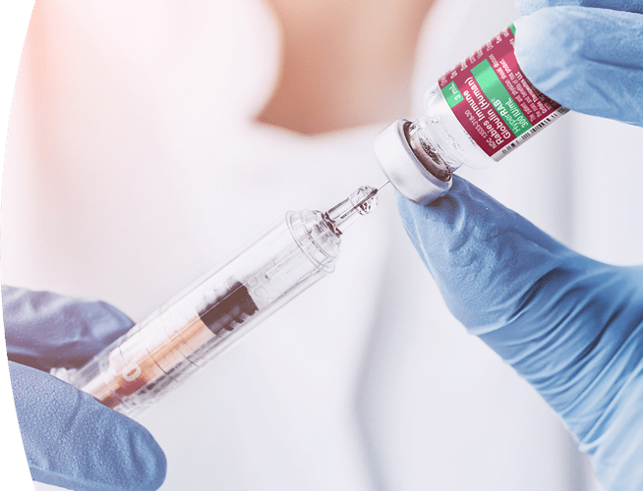
SUCCESSES AND CHALLENGES
Notes:
Both health departments responded rapidly and effectively…

Slide 27
SUCCESSES AND CHALLENGES
100% completion
Notes:
Achieving a 100% rabies PEP completion for all campers that initiated the series.

Slide 28
SUCCESSES AND CHALLENGES
Notes:
However, there was some scrambling to acquire PEP and funding, especially for HD1 which handled the entire PEP series for group 1.
And for group 2, there were some hospital supply challenges;

Slide 29
SUCCESSES AND CHALLENGES
Notes:
Upfront costs for HD1 were also higher, due to the purchase of the full series for each camper.
At this time, reimbursement is still pending for both HDs,

Slide 30
SUCCESSES AND CHALLENGES
Notes:
But thankfully, in both groups, not only were all campers insured, out of pocket costs should be covered by church funds.

Slide 31
PREPAREDNESS
Notes:
So what can we learn from these responses to prepare for future mass exposures?

Slide 32
PREPAREDNESS
Notes:
Implementing an ICS structure can help with multi-level organization, coordination, and resource management

Slide 33
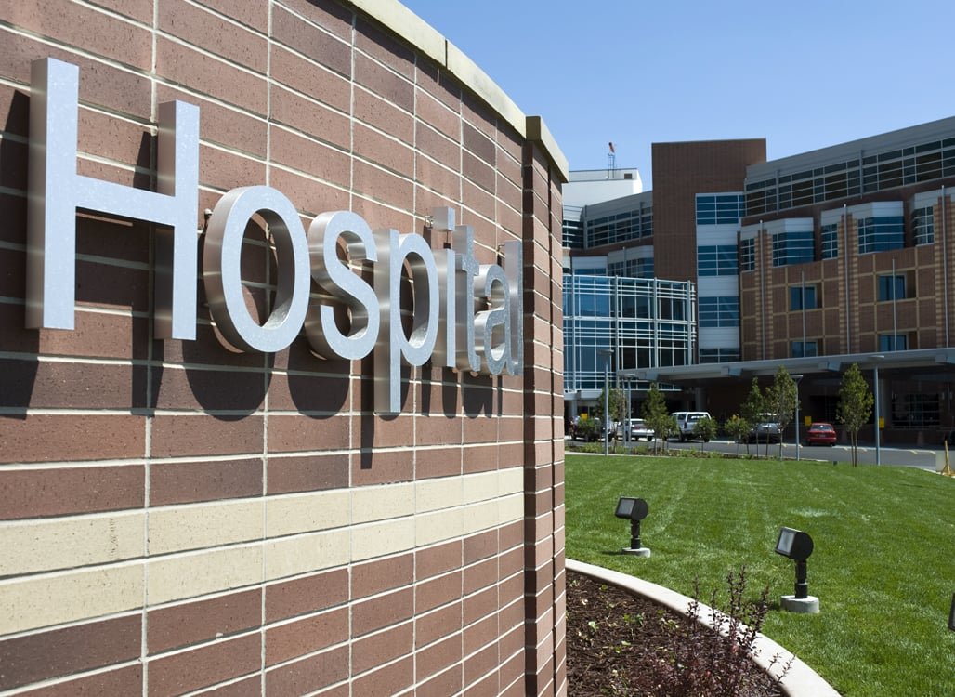
PREPAREDNESS
Notes:
And having established contacts with hospital systems and vaccine vendors can help obtain supplies.

Slide 34
PREPAREDNESS
Notes:
Also, having established funding, or knowledge of funding resources can help with financial aspects of a large scale response.

Slide 35
Notes:
These responses also show us that there is no ‘one size fits all’ protocol to follow here
Ultimately, LHDs know their community best and each community has varying characteristics that will influence what steps need to be taken for an effective response
Factors such as…

Slide 36
Notes:
language and cultural characteristics,

Slide 37
Notes:
vaccine sentiment,

Slide 38
Notes:
PEP availability and insurance status,

Slide 39
Notes:
and transportation and time barriers are important to ensure equitable administration of rabies PEP on a mass scale.

Slide 40
ACKNOWLEDGEMENTS
Utah Department of Health and Human Services
Bear River Health Department
Centers for Disease Control and Prevention
Davis County Health Department
Idaho Department of Health and Welfare
Intermountain Healthcare
Idaho Fish and Game
Church of Jesus Christ of Latter-day Saints
Notes:
I’d like to acknowledge the following groups for their key roles in these responses and this analysis. Thank you!

Slide 41
HD1
HD2
33 exposed
42 exposed
1 no contact
8 no contact
32 recommended PEP
33 recommended PEP
2 received PEP in ID
1 LTFU
3 LTFU
30 received PEP
29 received PEP at HD1 clinic
9 received all PEP in hospital
21 received HRIG + 1 dose in hospital and remaining vaccine at HD2 clinic

Slide 42
Patient assistance programs
Patient assistance programs that provide medication to uninsured or underinsured patients may be available for qualiﬁed patients through rabies vaccine and rabies immunoglobulin manufacturers. For more information on these programs including eligibility requirements, please contact the manufacturers directly.
Rabies vaccine
Sanoﬁ Pasteur–Imovax® Phone: 1-800-822-2463 www.sanoﬁpasteur.us
Bavarian Nordic–Rabavert® Phone: 1-844-422-8274 https://bnvaccines.com
Human rabies immunoglobulin
Grifols–HyperRab® Phone: 1-833-504-9983 www.hypermunes.com/en/hcp
Kedrion–KEDRAB® Phone: 1-866-234-3732 https://mykedrab.medmonk.com

Slide 43
LEARNING OBJECTIVES
Participants will compare and contrast different mass rabies PEP administration options, considering effectiveness, equity, cost-efficiency, and suitability for various scenarios
Participants will be able to identify and assess potential challenges to mass administration of rabies PEP in their jurisdiction, including issues related to equitable administration, cost, reimbursement, obtaining PEP, and organizing and tracking PEP administration
Participants will understand the importance of preparing operational plans and establishing contacts with rabies PEP vendors, funding sources/partners, and hospitals for future mass rabies exposures

Slide 44
A TALE OF TULAREMIA, CHAPTER 3
Brent D. Nelson, DO, FAAP
Pediatric Infectious Diseases
Fellow
© UNIVERSITY OF UTAH HEALTH
Notes:
Hello, my name is Brent Nelson. I am a pediatric infectious diseases fellow at Primary Children’s Hospital. I’m very grateful and excited to tell our story as it relates to the Tularemia outbreak earlier this summer.

Slide 45
Notes:
Our story begins in Box-Elder County around mid-April, when a mother, in her 3rd trimester fell ill. She had a past medical history of Crohn’s disease on treatment with REMICADE, which she received one week prior to falling ill with fever, sore throat, conjunctivitis and an enlarged lymph node on her neck. She presented to an urgent care and was tested negative for strep throat and covid. About 6 days into her illness, she went to the emergency department for further evaluation. A CT scan of her head and neck revealed an enlarged right cervical lymph node. ENT evaluated her and gave her a does of antibiotic and a steroid (CTX + Dex). She was sent home.
4 days later, on day 10 of illness, she perceived decreased fetal movement, and she was seen by her OB. They preformed an extended ultrasound evaluation called a biophysical profile which was reassuring. ENT re-evaluated her and removed the enlarged lymph node. Despite encountering a lymph node which was clearly infected, her cultures remained negative. She was treated with an antibiotic called Augmentin, and had some improvement, however the cause of her illness remained unknown.
At 37 weeks, her infant was born via C-section due to maternal hypertension and “to simplify the management of her other chronic medical conditions”. She also underwent elective salpingectomy. Her prenatal infectious labs which tested for HIV, Syphilis, Hep B, Hep C, and GBS were negative. A healthy baby boy was born. He required 15 mins of respiratory support at delivery but transitioned successfully to room air and sent home at 48 hrs of life.

Slide 46
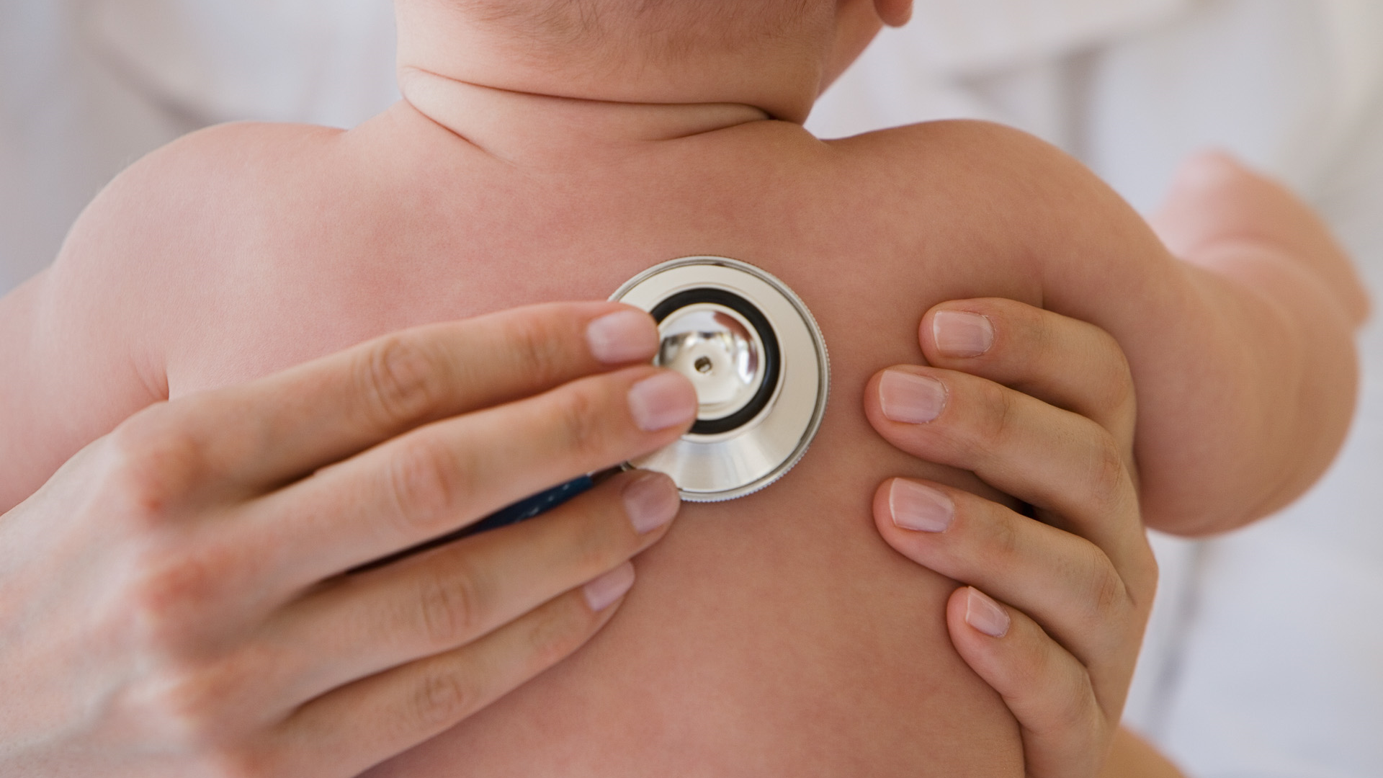
Notes:
At two weeks of age, the infant was taken to the local ED due to poor feeding (0.5 – 2 oz every 2 hrs), increased sleepiness (up to 8 hrs at a time), and some elevated temps (had fever to 103 @ PCP 4 days prior to circumcision, but on re-checking was back to 100).
On presentation he had an elevated heart rate and low-normal oxygen saturation concerning for infection. ED Vitals: T 37.7, HR 181, RR 60, BP 84/67, SpO2 92%
A full set of labs were obtained (CBCd, CMP, ESR, CRP) as well as a lumbar puncture. Blood, CSF and Urine cultures were collected, and the infant was started on antibiotics. (Ampicillin and Ceftazidime). IV fluids were also given. As he was being observed, he became hypoxic, and oxygen was started. Due to increasing lethargy, a now pale/mottled appearance and overall worsening status, the infant was transferred via life flight to the pediatric ICU in PCH, Lehi.

Slide 47
LAB RESULTS
WBC 56.8 (Neutrophils 29.0, Lymphocytes 19.9, Monocytes 4.5)
AST/ALT elevated 898 and 316
Procalcitonin 3.02
CRP 17.1
Urine w/ 8 WBC/HPF, otherwise normal
CSF w/ 48 WBC (81% lymphocytes)
Rhinovirus +
Notes:
His lab abnormalities are shown here.

Slide 48
ADDITIONAL EVALUATION
On arrival to Lehi PICU, the infant had fever to 39.6, which resolved 6 hours later
Ganciclovir added with serum and CSF HSV obtained (resulted negative and ganciclovir was later d/c’d)
PCR testing of CSF negative for Enterovirus. Meningitis/Encephalitis (ME) panel was also negative.
PCR testing of serum was negative for Adenovirus, Parvovirus B19 and CMV.
KUB showed possible concern for pneumatosis on one image, resolved on subsequent x-rays
Notes:
On arrival to the PICU, he had a fever to 39.6 (103.2 F) which resolved while on antibiotics. Ganciclovir was briefly added until Herpes simplex virus infection was ruled out. The infant was tested for many other possible causes of infection, all which returned negative.
He did have an abdominal x-ray which was abnormal, showing air within the intestinal wall) however repeat imaging was reassuring.
Additional testing included
CSF – culture, PCR for herpes simplex virus, enterovirus and meningitis encephalitis panel (vzv, GBS, listeria, S. pneumo, H influenzae, N. meningitidis, E. coli k1, HSV 1, 2, HHV6, Parechovirus, Cryptococcus neoformans/gatii)
Serum – culture, PCR for HSV, Adenovirus, Parvovirus B19, and CMV

Slide 49
HOSPITAL COURSE
Infant developed thrombocytopenia down to low of 115 which later improved to 149 (normal 150).
With negative cultures and reassuring physical examination, normalized CBC, and improving markers of inflammation (CRP - 6.8 from 17.1) antibiotics were discontinued on hospital day 4.
Discharged home on day 5.
Notes:
Labs were collected daily. Initially his platelets, which were previously normal, dropped to a level of 115 and subsequently improved. After 3 days of antibiotics with no growth on cultures, antibiotics were discontinued. He was observed for an additional day off antibiotics and discharged home with a normal exam as well as improvement of all lab abnormalities.

Slide 50
1 WEEK LATER (4 WEEKS OF AGE)
Vitals Normal
Labs:
WBC 25.2 (elevated Monocytes to 3.5), New thrombocytosis to 584
CRP 4.7
UA + for trace leukocyte esterase
CSF w/ glucose 36, protein 81, WBC 31 (Neut 4%, Lymph 71%, Mono 25%), RBC 7
Notes:
Unfortunately, 1 week later (now 4 weeks of age): He returned to the emergency department again with similar symptoms as before (pale appearance, poor feeding and increased sleepiness). This time his vitals were normal, however labs remained altered. Specifically, he had WBC elevation, Platelet elevation, CRP elevation, UA abnormal and CSF still demonstrating elevated WBC count.
Normal vitals
Repeat labs showed:
WBC 25.2 (elevated Monocytes to 3.5), New thrombocytosis to 584
CRP 4.7
UA + for trace leukocyte esterase
CSF w/ glucose 36, protein 81, WBC 31 (Neut 4%, Lymph 71%, Mono 25%), RBC 7

Slide 51
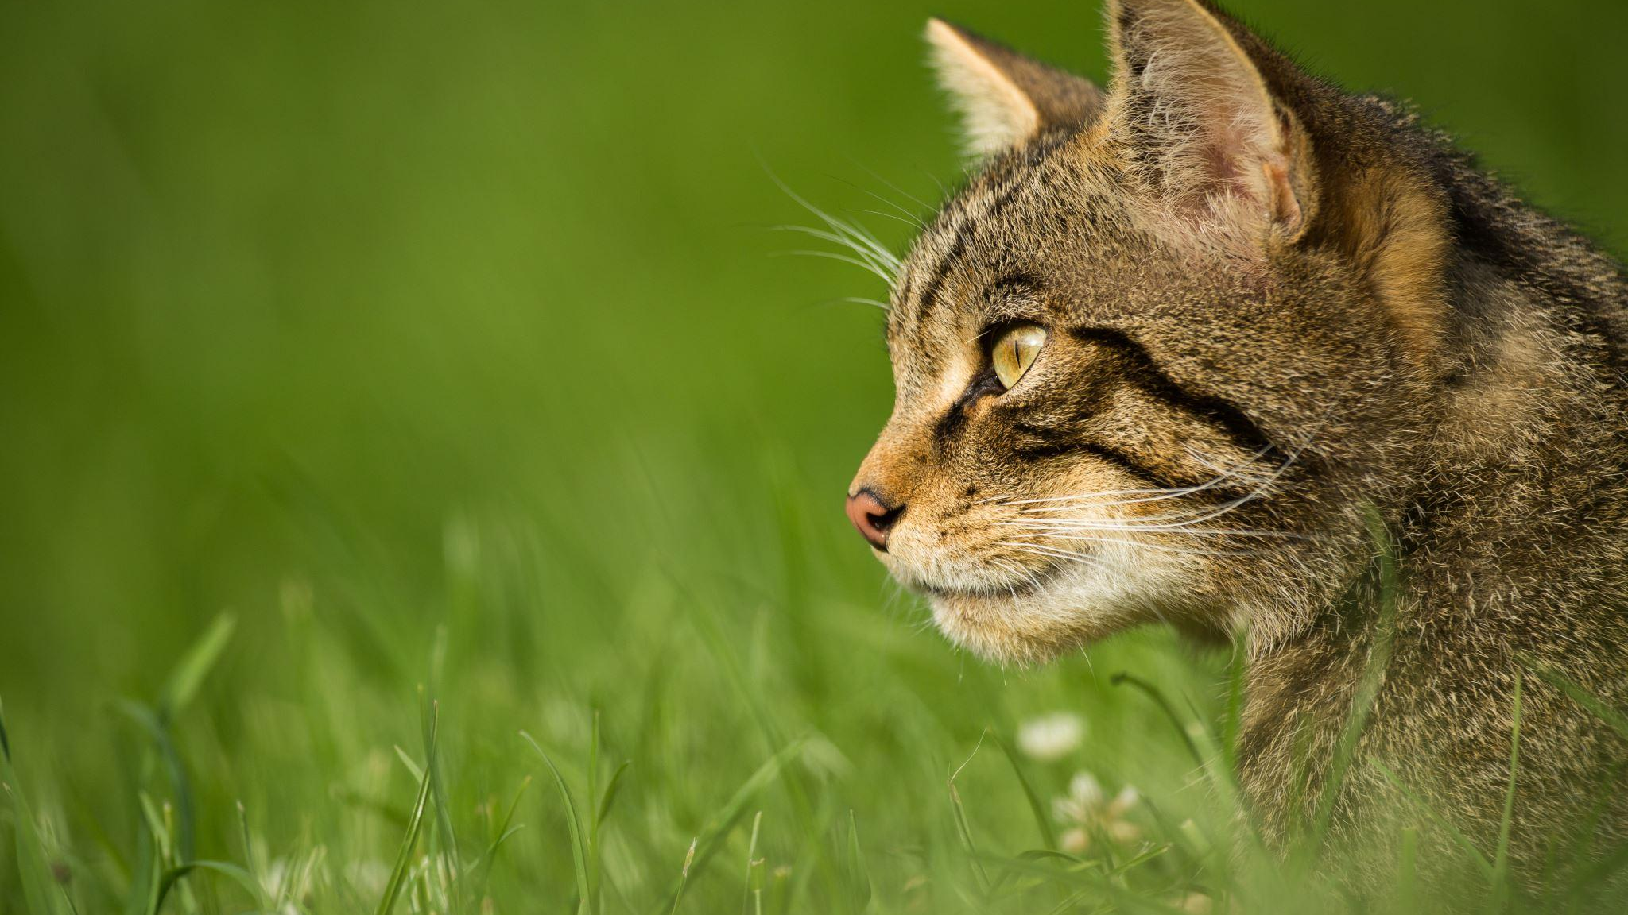
Notes:
This is when I first met the patient. His mother was doing okay, but still felt under the weather. She seemed stressed, but hopeful that we could figure out a diagnosis. Speaking with her, we learned about the exposures leading up to their illness. The family was from Box-Elder County and were living on a 5-acre property. Her husband, who has some chronic medical conditions, also had some chronic wounds on his legs attributed to poor blood flow. These were not currently draining fluid but had in the past. Their home is supplied with well water and had never tested it for coliforms. The infant was fed from a bottle with either formula or breast milk.
There were many animals in the home including 2 bird hunting dogs. The father enjoys hunting and while they do not regularly eat game meat did have elk several months ago. He last hunted geese in the fall/winter. He may have helped a friend process deer or elk, but the timing of that is unclear.
They also had an Angora rabbit which the family rescued from a home near the mother’s workplace. They also have chickens which roam the yard.
Finally, they have a cat who was rescued in 2017. This was an outdoor cat who frequently hunted outside. The cat was acting ill prior to its death, reportedly throwing up worms. They intended to bring it to the vet, but with the infant’s illness, this never happened, and the animal was run over by a hay cutter.
We also learned later on that there were canals near their home. While no dead animals were found in the area, a neighbor did occasionally trap beavers from the canal.

Slide 52
ADDITIONAL EVALUATION
Karius (microbial cell-free DNA) testing
Brain MRI
Notes:
With this information, having an elevated suspicion for possible brain infection because of the abnormal lumbar puncture, we proceeded with brain imaging and a blood test called Karius.

Slide 53
WHAT IS KARIUS?
Notes:
You may be aware of a blood test (NIPT or Non-invasive perinatal testing). This is used in pregnancy to determine the sex of the infant and screen for genetic conditions such as Trisomy 21. The same technology which allows for detection of fetal DNA can be utilized to extract DNA from various pathogens. This is referred to as microbial cell free DNA.

Slide 54
WHAT IS KARIUS?
MICROBIAL CELL FREE DNA
Notes:
To send this test, we collect 5ml of blood and send it to the Karius lab in California. Processing includes extracting the DNA, sequencing and analyzing the DNA sequences. DNA sequences are then compared to those in their database and if a match is made, a positive result is flagged. From the time the blood is received, a result is given in about 24 hours. This is reported back through a mobile app.

Slide 55
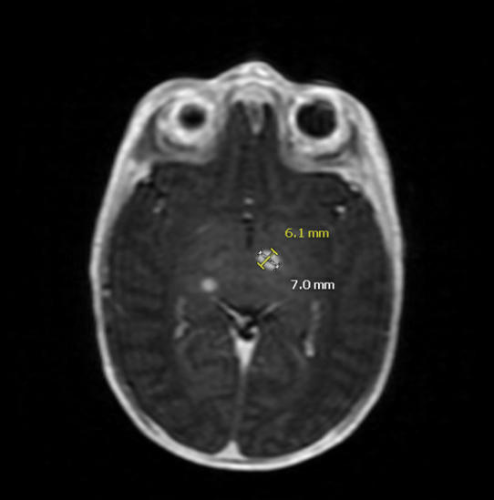
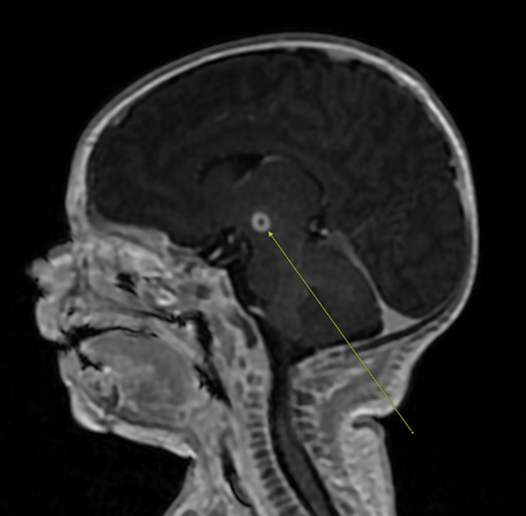
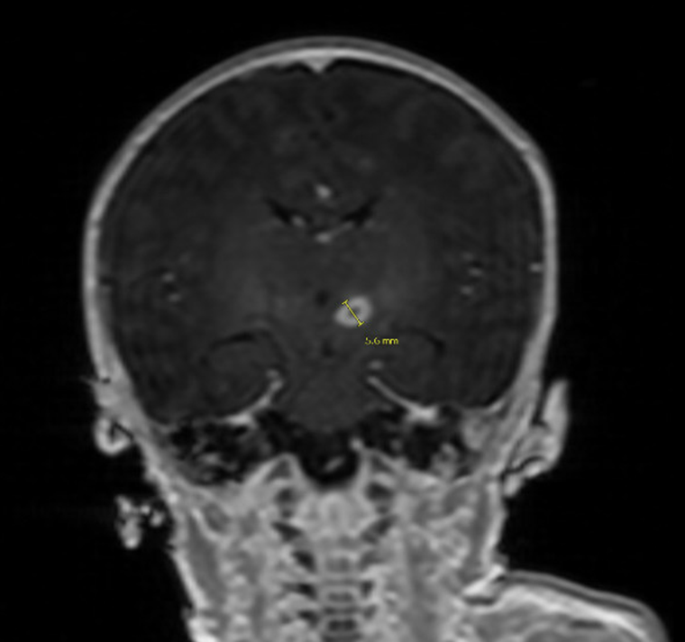
MRI Brain
Lesion 1: 7x6x6 mm lesion centered near the left subthalamic nucleus.
Demonstrates rim enhancement and faint central gradient susceptibility w/o
definite diffusion restriction
Notes:
While we were awaiting the Karius result, MRI imaging revealed 3 brain lesions.

Slide 56
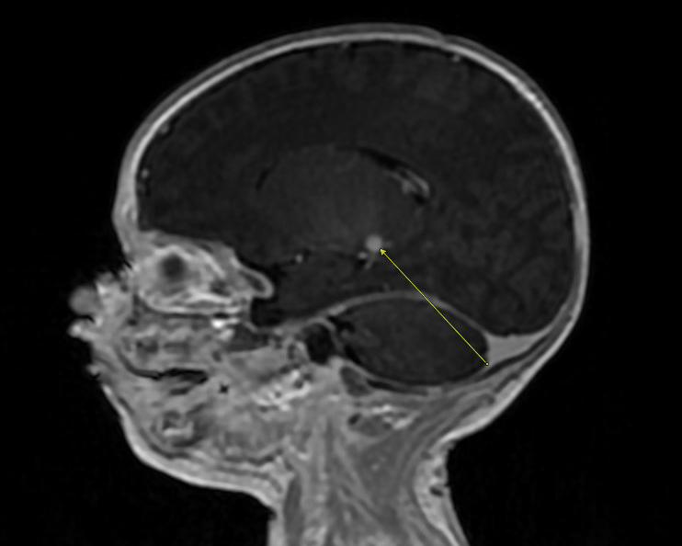
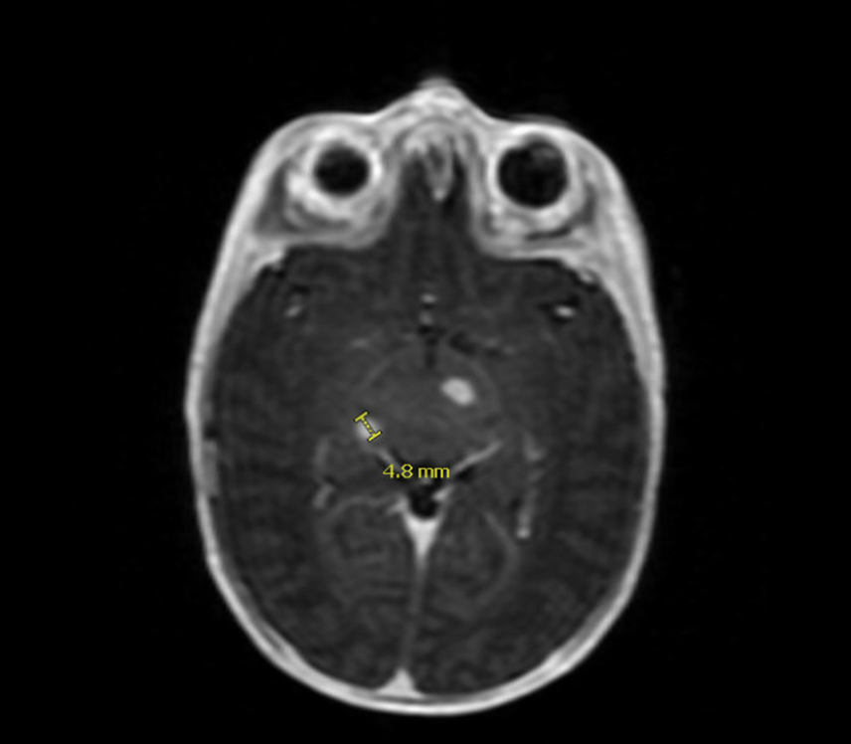
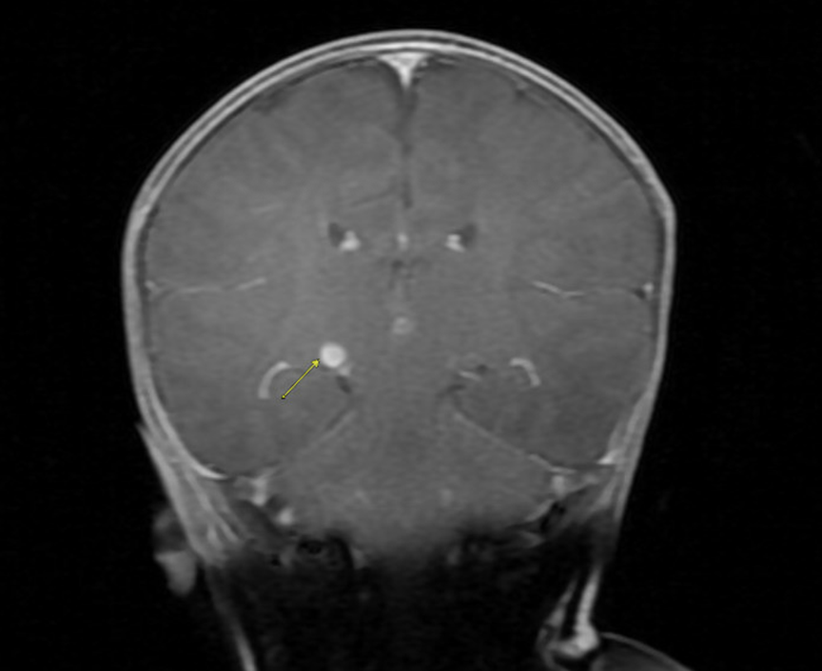
MRI Brain
Lesion 2: 5mm enhancing lesion centered at the most inferior aspect of
the right thalamus.

Slide 57
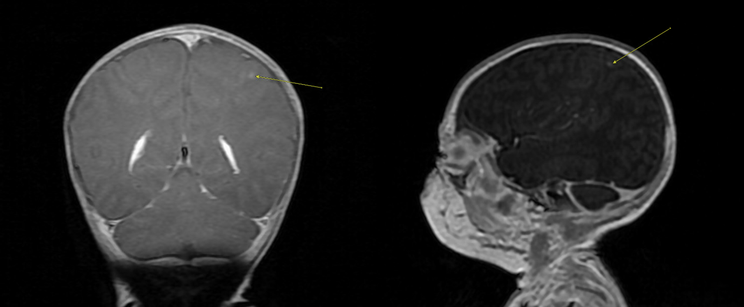
MRI Brain
Lesion 3: 2mm enhancing lesion in the L. parietal cortex

Slide 58
ADDITIONAL EVALUATION
Toxoplasma PCR sent from CSF
Notes:
Because of the imaging characteristics, we added on toxoplasma PCR testing to the CSF.

Slide 59
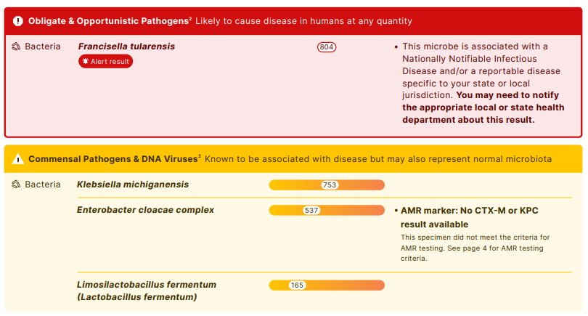
Notes:
It was my day off, I was helping my my kids get ready for church when I received this result on my phone. I stopped what I was doing and sent a message to Dr Knackstedt who was on service that day. You can see here the result with F. tularensis. There were a couple other less important bacteria detected as well.

Slide 60
Notes:
As you can see from my text, The result was shocking and unexpected! I could not believe it! Tularemia? In a 2 month old? I had trouble focusing on anything else for the rest of the morning.
Typically, the detection of Tularemia is done by culture of infected tissue, PCR testing, Serology or Immunohistochemical stains from tissue. So getting this result on a Kairus was cool, but even more thrilling was that was the possibility of congenital infection, which, to my knowledge had never been described.

Slide 61
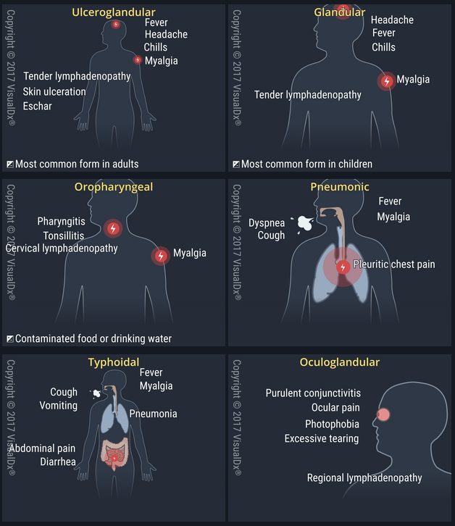
HUMAN TULAREMIA
COMMON PRESENTATIONS
Ulceroglandular/Glandular
Oropharyngeal
Oculoglandular
Pneumonic
Typhoidal
Notes:
To provide some context these are the typical manifestations of tularemia.
An infection occurs following exposure to the organism Francisella tularensis. Common exposures include animals such as infected rabbits and hares, rodents or domestic cats and dogs, to name a few. Arthropod vectors such as the deer fly and ticks can also transmit disease. Individuals exposed in these ways often develop ulceroglandular or glandular presentation, meaning they have a skin ulcer where the infection began and a local lymph node becomes enlarged.
The infection can also occur through the ingestion of contaminated food or water. This often presents with the oropharyngeal or oculoglandular syndrome.
A concerning presentation of disease is pneumonic tularemia. Pneumonic tularemia occurs when contaminated aerosols are inhaled. For example, people have been infected when mowing their lawn and accidently running over a dead animal in the grass. The potential for aerosol transmission also makes this organism a category A bioterrorism agent.
Finally, typhoidal can develop following type of exposure.
Ulceroglandular disease
Glandular variant (regional lymphadenopathy w/out ulcer)
Oculoglandular (severe conjunctivitis, with preauricular lymphadenopathy)
Oropharyngeal (exudative stomatitis, painful pharyngitis, or tonsilitis w/ cervical lymphadenopathy)
Typhoidal (high fever, septicemia, possible hepato/splenomegaly)
Pneumonic tularemia (fever, cough, chest pain, hilar adenopathy)

Slide 62
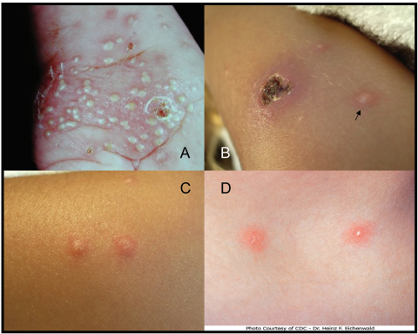
HUMAN TULAREMIA
UNCOMMON PRESENTATIONS
Osteomyelitis
Septic Arthritis
Endocarditis
Peritonitis
Encephalitis/Meningitis
Vesicular eruption
Carrie L. Byington, et al., Tularemia with Vesicular Skin Lesions May Be Mistaken for Infection with Herpes Viruses, Clinical Infectious Diseases, Volume 47, Issue 1, 1 July 2008, Pages e4–e6, https://doi.org/10.1086/588843
Notes:
Some uncommon presentations of tularemia include localized infection of the bone, joints, heart, abdominal lining, and the brain. In 2008 our group also described a unique prestation of tularemia manifesting with a vesicular like eruption like HSV or Varicella.
You’ll notice. . . Congenital infection is not on this list.

Slide 63
MOTHER EVALUATION WITH INFECTIOUS DISEASE
Continued symptoms (night sweats, arthralgias)
F. tularensis testing:
Serum immunoglobulins IgM +, IgG +
Throat culture
Treatment: Ciprofloxacin x 10 days
Notes:
Having discovered the possible cause of the mother’s Illness, she was evaluated by our adult ID colleagues. Although she was feeling better, she was not entirely back to her baseline yet and was experiencing night sweats and arthralgias.
She and her husband were evaluated. F. Tularensis testing was sent including serology and a throat culture. Positive serology in the mother confirmed a diagnosis of tularemia, and she was treated with Ciprofloxacin for 10 days. The father’s testing was negative.

Slide 64
ADDITIONAL NEONATAL EVALUATION AND TREATMENT
Additional Evaluation
Positive F. tularensis IgG, negative IgM
Review of pathology from maternal salpingectomy revealing for L. salpingitis
UCSF mNGS sent from CSF was negative
Treatment
IV Gentamicin x 7 days
IV Ciprofloxacin x 4 weeks
Notes:
We also preformed serologies on the infant which were positive for IgG and negative for IgM. You may recall me mentioning mother had a salpingectomy at the time of her c-section. Interestingly, review her L. salpinx pathology results showed evidence of salpingitis. Another test was sent from the CSF to detect DNA in the spinal fluid, but this returned negative. The infant’s blood was also sent to the health department for tularemia PCR testing, and this was negative.
We consulted the health department and CDC and with their help decided on a treatment plan. They also helped us to send the mother’s inflamed fallopian tube on to the CDC for special staining of tularemia.
The infant responded well to therapy.
There was another re-admission for and episode of emesis and poor feeding near the end therapy (entire family was sick with GI bug at that time and everyone who had not been previously tested had tularemia serologies obtained which had a negative result). The infant’s blood cultures remained negative. We repeated a Karius which was still positive for F. tularensis, but had quantitative improvement w/ MPM of 11 (previous was 804). An MRI near end of therapy showed resolution of the 3 lesions with only “trace residual focus of enhancement in the left subthalamic region”.
With these findings, we felt comfortable treating for 4 weeks and stopping antibiotics. Currently the infant is doing very well.
During hospitalization he did have rapid WGS was abnormal for 2 genetic mutations of unknown significance.
Association with autosomal recessive SCID. Initial testing was reassuring, and he will follow up with immunology at 1 year of age.

Slide 65
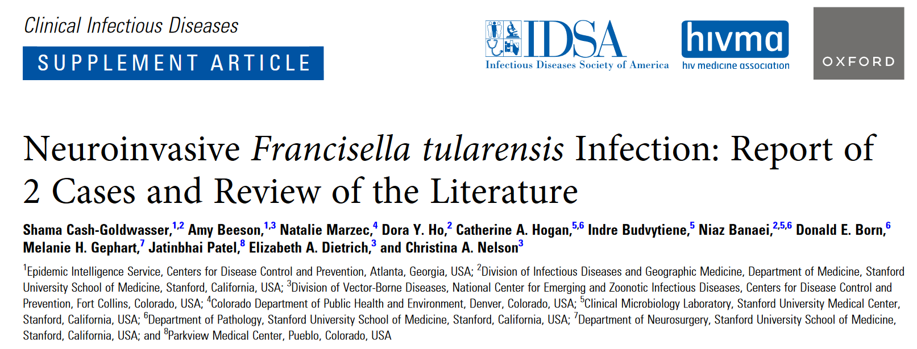
Notes:
This is one of the articles which was helpful to guide our treatment of the infant.
In February of 2024, this article was published in CID
Review of the literature from 1950 – present
16 published cases of neuroinvasive T. Tularensis , 4 in which tularemia was clinically suspected
CSF often displayed lymphocytic pleocytosis (as was the case in our infant)
CSF culture was positive in 13 of 16 cases and F. tularensis antibodies detected in 11/11 cases that tested for the antibodies
Treatment: Gentamicin + Targeted treatment for F. tularensis (Ciprofloxacin, Levofloxacin, Doxycycline, Chloramphenicol)
Duration: 10 – 21 days (one patient received 7 mo due to immunocompromised status)

Slide 66
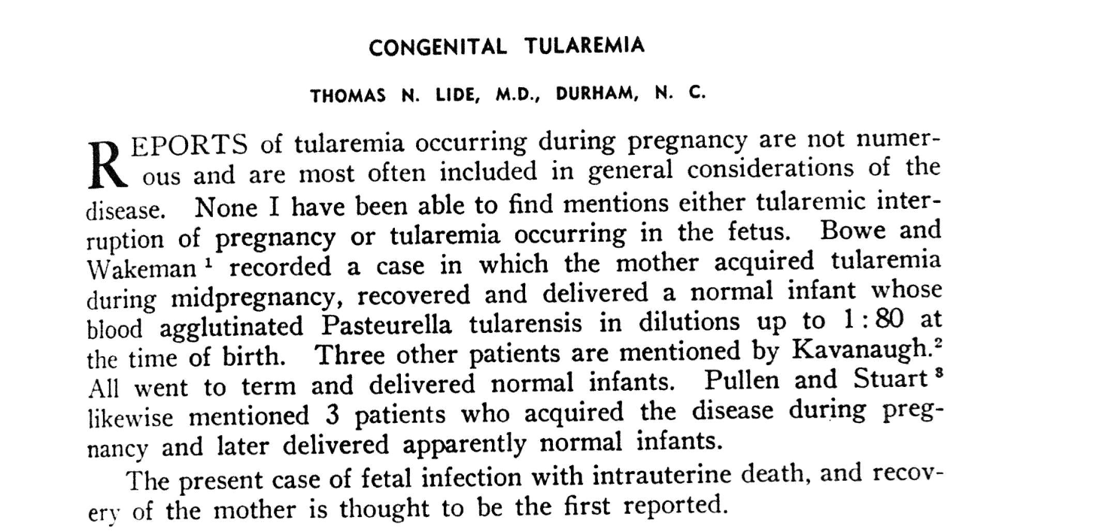
CONGENITAL TULAREMIA?
Notes:
The big question: Was this congenital infection??
In our literature search, a CDC representative made us aware of a story in the Archives of Pathology from 1947 describing a stillborn infant which occurred following the mother’s infection with tularemia.
They described a 30 y/o octipara developed a “sore” on her finger (2 weeks duration) after preparing a rabbit caught by a dog one week prior to onset of illness. 2 additional children age 14 and 8 yrs had been hospitalized due to tularemia.
P. tularensis infection diagnosed by agglutination tests. On day 6 of hospitalization, she felt no fetal movement, but fetal heart sounds were still audible in RLQ of abdomen. Patient afebrile during first 7 days of hospitalization. Day 8 developed fever to 101.4. Day 9 fever was increasing and fetal heart sounds were no longer auscultated. Day 11 she delivered a still-born infant.
Blood from the umbilical cord at the time of delivery was positive for agglutination test for P. tularensis.
2 Chorionic villi found to contain clumps of gram negative coccobacilli. There were also lesions of placental necrosis.
About 1 mo ago we received results from immunohistochemistry on the mother’s L. salpinx (which you may recall did show some inflammation). The stains were positive for: Fallopian tube, left, salpingectomy (05/16/2024): Subacute suppurative salpingitis with serositis. See comments.
- Immunohistochemical evidence of Francisella tularensis was positive.
- 16S rRNA gene PCR test to be performed.

